Slide 1

AMERICORPS COMPETITIVE NOTICE OF FUNDING OPPORTUNITY
2023/24
TECHNICAL ASSISTANCE SESSIONS
General T/A Session,
Wednesday, October 5, 2022, 10:00 am
Theory of Change T/A Session on Tuesday, October 11, 2021, 10:00 am

Slide 2
DATE | ACTIVITY
September 20-21 | Dissemination of NOFO flyer announcing the 2023/24 Competitive AmeriCorps Grants competition. NOFO goes live on the NJ DOS website https://www.state.nj.us/state/volunteer-grant-opportunities.shtml
October 5 | Competitive NOFO Technical Assistance Session via ZOOM. Live at 10:00 am. Register here to attend the live session. Session will be recorded and available at the NJ Department of State AmeriCorps grants website within 24-48 hours.
October 11 | Technical Assistance Session on Theory of Change, Evidence, Logic Models and Performance Measures via ZOOM. 10:00 am. Register here to attend the session. Recorded session will be posted on NJ DOS website within 24-48 hours.
November 9 | Notice of Intent to Apply due to Commission. Form available on https://forms.office.com/g/bc4usvqUkK
November 17 | Competitive applications due to Commission on eGrants by 4:00 pm.
November 21 | CREEHS and Staff review of applications and budgets are begun.
December 8 or 9 | Reader Arena Session via ZOOM. Arena scores and final rankings
December 13 | Notification of applicants selected and Reader/CREEHS revisions requested for applications recommended for funding
December 19 | Final revisions from applicants due back in eGrants
December 20 | Final staff review on revisions
December 21 | NJ Commission board vote on selected applicants
December 29 | NJ Commission target date for submission of Competitive package to AmeriCorps (NOFO due date is January 4).
Mid April 2023 | Successful applicants to be notified
Mid July 2023 | Commissions with successful applicants will be awarded. Commissions will award sub-recipients for a September 1, 2023 start date.

Slide 3
NOFO Sections
Section I: NJ Commission Grant Information and Timelines
Section II: 2023Corporation on National and Community Service NOFO
Section III: 2023 Mandatory Supplemental Guidance
Section IV: 2023 Corporation Application Instructions

Slide 4
NOFO Sections
Section V: 2023 Performance Measures
Section VI: Evaluation Plan Template
Section VII: Financial Management Survey
NOTE: Links to Sections II – VII are available in the NOFO Section I and also at the end of the Section I NOFO.

Slide 5
NOFO Application Focus Areas for Performance Measures
Economic Opportunity
Education
Healthy Futures
Veterans and Military Families
Disaster Services
Environmental Stewardship

Slide 6
Economic Opportunity
Improving the economic well-being and security of underserved individuals.

Slide 7
Education
Improving educational outcomes for underserved people, especially children. AmeriCorps is particularly interested in program designs that support youth engagement and service learning as strategies to achieve high educational outcomes.

Slide 8
Healthy Futures
Support for health needs within communities, including mitigating the impacts of COVID19 and other public health crises, access to care, aging in place, and addressing childhood obesity, especially in underserved communities.

Slide 9
Veterans and Military Families
Improving the quality of life of veterans, military families, caregivers, and survivors.

Slide 10
Disaster Services
Helping individuals and communities prepare for, respond to, recover from, and mitigate the effects of disasters and increase community resiliency.

Slide 11
Environmental Stewardship
Supporting communities to become more resilient through measures that reduce greenhouse gas emissions, conserve land and water, increase renewable energy use and improve at-risk ecosystems, especially in underserved households and communities.

Slide 12
Funding priorities
Organizations leading service in communities with concentrated poverty, rural communities, tribal communities, and those organizations serving historically underrepresented and underserved individuals, including but not limited to communities of color, immigrants and refugees, people with disabilities, people who identify as part of the LGBTQIA+ community, people with arrest and/or conviction records, and religious minorities;

Slide 13
Funding priorities (cont.)
Evidence-based interventions on the AmeriCorps Evidence Exchange that are assessed as having Moderate or Strong evidence. Please note that many of these interventions have demonstrated effectiveness in improving outcomes for individuals living in underserved communities and that the agency has committed resources to supporting grantees seeking to replicate and evaluate these interventions in similar communities

Slide 14
Funding priorities (cont.)
To receive priority consideration, applicants must show that the priority area is a significant part of the program focus and intended outcomes. Proposing programs that receive priority consideration does not guarantee funding.

Slide 15
Funding priorities (cont.)
* Veterans and Military Families, Caregivers, and Survivors – a program model that improves the quality of life of veterans and improves the well-being of military and veteran families, caregivers, and survivors,
• Faith-based organizations;
• Programs that provide additional benefits to AmeriCorps members aimed at enhancing member experience and bolstering member recruitment and retention such as paying more than the minimum living allowance, transportation, housing, food, etc.;

Slide 16
Funding priorities (cont.)
*Programs that create workforce pathways for AmeriCorps members, including deliberate training, certifications, and hiring preferences or support; and
• Environmental Stewardship, including supporting communities to become more resilient through measures that reduce greenhouse gas emissions, conserve land and water, increase renewable energy use and improve at-risk ecosystems, especially in underserved households and communities.
• Economic Mobility Corps (See Appendix II.

Slide 17
Performance Measures
All applications must include at least one aligned performance measure (output and outcome) that corresponds to the proposed primary intervention. This may be a National Performance Measure or an applicant-determined measure. See the Performance Measure Instructions for details about performance measure requirements and selection rules.
Performance Measure Instructions.
AmeriCorps State and National Performance Measures Instructions 2023

Slide 18
Determine Type of Program
REGULAR COST REIMBURSEMENT
  Funds a portion of program costs and members’ living allowance.
PROFESSIONAL CORPS
  Professional Corps programs place professionals in communities where there is a documented shortage of such professionals.
  Stipends/salaries are paid by other organizations.
  Can be either cost reimbursement or fixed-amount.
FULL COST FIXED-AMOUNT GRANTS (Only available for recompeting applications)
  Applicants apply for a fixed amount per MSY* & use their own or other resources for the remaining cost of the program. No match requirements, but the program must still raise the additional funds needed to run the program.
  *Member Service Year

Slide 19
Organizational Eligibility to Apply
Eligibility is open to:
Indian Tribes
institutions of higher education
local governments
nonprofit organizations
state service commissions
states and US Territories

Slide 20
Page Limitations
There are two sections with mandatory page limits: Narrative and Logic Model.
Applications must not exceed 10 pages for the Narrative or 12 pages for Rural Intermediaries.
In determining whether an application complies with page limits, the Corporation will count the following for the Narrative:
The application’s Executive Summary, SF 424 Facesheet, and The Narrative portions contained in the Program Design, Organizational Capacity, and Cost Effectiveness and Budget Adequacy sections of the application.
The Corporation strongly encourages applicants to print out the application from the “Review” tab prior to submission to check that the application does not exceed the page limit. The application page limit does not include the Budget, narrative portion of the Evaluation Plan, the Logic Model, performance measures, or the supplementary materials, if applicable.

Slide 21
Page Limitations
LOGIC MODEL
The Logic Model may not exceed three pages when printed with the application from the “Review” tab in eGrants.
Please note the length of a document in word processing software may be different than what will print out in the AmeriCorps' web-based system. Reviewers will not consider any submitted material that exceeds the page limits in the printed report, also, note that the system will not prevent an applicant from entering text that will exceed page limitations.
This applies to both the application page limit and the Logic Model page limit.

Slide 22
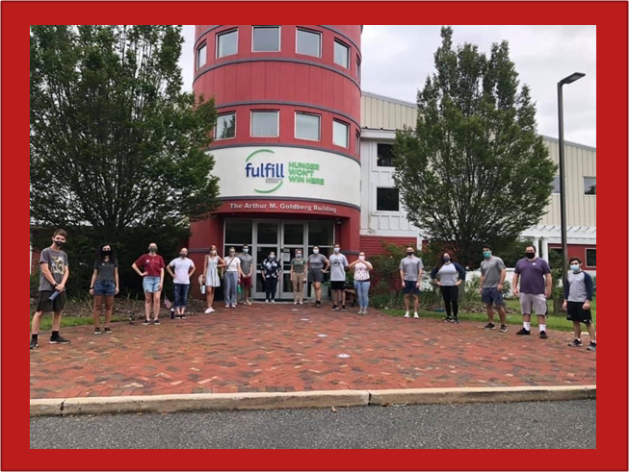
Funding Period
For New and Recompeting applicants, this is Year 1 of 3 of a multi-year grant period covering the following funding periods:
  Year 1: Sept 1, 2023 to August 31, 2024
  Year 2: Sept 1, 2024 to August 31, 2025
  Year 3: Sept 1, 2025 to August 31, 2026

Slide 23

Notice of Intent To Apply
Applicants must fill out and submit the online Intent to Apply form by Wednesday, November 9, 2022, 4:00 p.m.
The following information is required:
  Organization Name
  Address
  Contact Name
  E-mail Address
  Phone Number
  Focus area/s application will address
  Applying as New or Continuation and Regular Cost Reimbursement or Fixed Amount.
  Click here to complete:
  NOTICE OF INTENT TO APPLY form
  (The form can be also be found on our website)

Slide 24
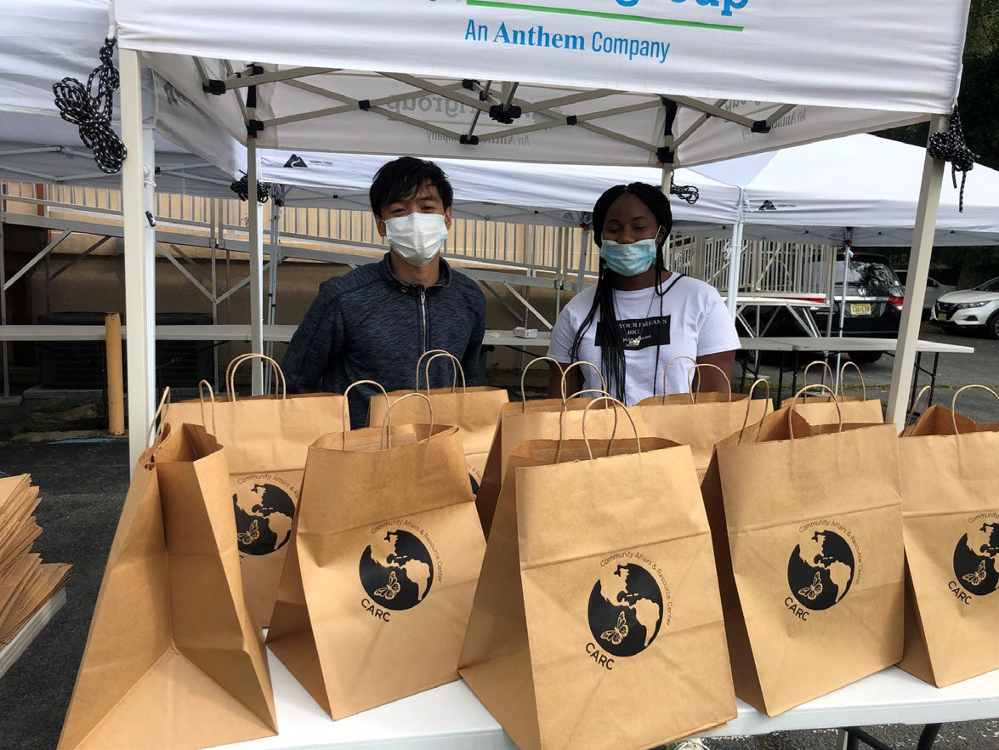
Applications must be submitted electronically on eGrants
NO LATER THAN
Thursday, November 17, 2022, 4:00 p.m.

Slide 25
Additional Documents
All documents that are requested in Section II: AmeriCorps NOFO need to be sent to the NJ Commission and not to AmeriCorps. The NJ Commission will forward additional documents to AmeriCorps upon selection of the application at the NJ level. Please see the CNCS NOFO, Section I for further directions on submission of additional documents.
Applicants are required to submit the following additional documents by the application submission deadline:
  Financial Management Survey, Evaluation briefs, reports, studies. Please refer to the Evidence Base section for detailed instructions by evidence tier.

Slide 26
Unique Entity Identifier and System for Award Management (SAM)
All applicants must register with the System for Award Management (SAM) at https://www.sam.gov/SAM/ and maintain an active SAM registration until the application process is complete. If an applicant is awarded a grant, it must maintain an active SAM registration throughout the life of the award. See the SAM Quick Guide for Grantees.
Applicants must use their SAMregistered legal name and physical address on all grant applications to AmeriCorps. The legal applicant’s name and physical address in eGrants must match exactly the applicant’s SAM-registered information.
Applications must include an Employer Identification Number.
Applications must include a valid Unique Entity Identifier (UEI), which is generated as part of the SAM registration process.

Slide 27
PART 3 Selection Criteria
Category | Percentage
Executive Summary | 0
Program Design Theory of Change & Logic Model Evidence Tier Evidence Quality Notice Priority Member Experience | Total 50% 24 points 12 points 8 points 0 points 6 points
Organizational Capability Organizational Background & Staffing Compliance and Accountability Member Supervision | Total 25% 13 points 8 points 4 points
Cost-Effectiveness and Budget Adequacy | Total 25%

Slide 28
Review Criteria (see Section II of NOFO)
A. Executive Summary (Required – 0%)
Please fill in the blanks of these sentences to complete the executive summary:
The [Name of the organization] proposes to have [Number of] AmeriCorps members who will [service activities the members will be doing] in [the locations the AmeriCorps members will serve]. At the end of the first program year, the AmeriCorps members will be responsible for [anticipated outcome of project]. In addition, the AmeriCorps members will leverage an additional [number of leveraged volunteers, if applicable] who will be engaged in [what the leveraged volunteers will be doing.]
This program will focus on the AmeriCorps focus area(s) of [Focus Area(s)].* The AmeriCorps investment of $[amount of request] will be matched with $[amount of projected match], $[amount of local, state, and federal funds] in public funding and $[amount of non-governmental funds] in private funding.*
* Fixed Amount grant application- you may omit the section after the asterisk.

Slide 29
Review Criteria (cont.)
B. Program Design (50%)
NOTE: The following information will be reviewed on the October 5 THEORY OF CHANGE SESSION
Theory of Change & Logic Model
Evidence Tier
Evidence Quality
24 pts. 12 pts.
8 pts.

Slide 30
Theory of Change and Logic Model (TOC) ( 24 points)
The TOC shall address:
The problem is prevalent and severe in communities where the program plans to serve – documented with relevant data.
The proposed intervention is responsive to the identified community problem.
The intervention is clearly articulated including the design, dosage, target population and roles of AmeriCorps members.
The intervention is likely to lead to the outcomes identified in the TOC.

Slide 31
Theory of Change and Logic Model (TOC) ( 24 points) cont’d.
Outcomes in the narrative and logic model represent meaningful progress in addressing the community probem.
The rationale for utilizing AmeriCorps members to deliver the intervention(s) is reasonable.
The service role of AmeriCorps members will produce significant contributions to existing efforts and help develop additional capacity to address the stated problem.

Slide 32
Theory of Change and Logic Model (TOC) ( 24 points) cont’d
The Logic Model Shall Depict:
A summary of the community problem, including the role current or historical inequities faced by underserved communities may play in contributing to the problem.
The inputs or resources that are necessary to deliver the intervention, including but not limited to:
  Locations or sites in which members will provide services
  Number of AmeriCorps members who will deliver the intervention
The core activities that define the intervention or program model that members will implement or deliver, including:
  The duration of the intervention (e.g., the total number of weeks, sessions or months of the intervention)
  The dosage of the intervention (e.g., the number of hours per session or sessions per week)
  The target population for the intervention (e.g., disconnected youth, third graders at a certain reading proficiency level)

Slide 33
Theory of Change and Logic Model (TOC) ( 24 points) cont’d.
Logic Model (cont.)
The measurable outputs that result from delivering the intervention (i.e., number of beneficiaries served, types and number of activities conducted, equity gaps closed). If applicable, identify which National Performance Measures will be used as output indicators
Outcomes that demonstrate changes in knowledge/skill, attitude, behavior, or condition that occur as a result of the intervention. If applicable, identify which National Performance Measures will be used as outcome indicators.

Slide 34
Theory of Change and Logic Model (TOC) ( 24 points) cont’d.
Logic Model (cont.)
Note: The Logic Model is a visual representation of the applicant’s Theory of Change. Programs should include short, medium, or long-term outcomes in the Logic Model. Applicants are not required to measure all components of their Theory of Change. The applicant’s performance measures should be consistent with the program’s Theory of Change and should represent significant program activities.
In the application narrative, applicants should discuss the community need as it relates to the CDC’s Social Vulnerability Index.

Slide 35
Theory of Change and Logic Model (TOC) ( 24 points) cont’d.
Also in the application narrative, applicants should discuss their rationale for setting output and outcome targets for their performance measures.
Rationales and justifications should be informed by the organization’s performance data (e.g., program data observed over time that suggests targets are reasonable), relevant research (e.g. targets documented by organizations running similar programs with similar populations), or prior program evaluation findings.
Applicants with multiple interventions should complete one Logic Model chart which incorporates each intervention. Logic Model content that exceeds three pages will not be reviewed.

Slide 36
Evidence Base (20 pts)
The assessment of an applicant’s evidence base has two parts. First, the applicant will be assigned to an evidence tier (see the Mandatory Supplemental Information add hyperlink.)
Second, the quality of the applicant’s evidence and the degree to which it supports the proposed program design, including program aligned with the priority areas identified above, will be assessed and scored.

Slide 37
Evidence Tier (12 points)
Evidence Tier (12 pts.)
An evidence tier will be assessed for each applicant for the purpose of understanding the relative strength of each applicant’s evidence base and the likelihood that the proposed intervention will lead to outcomes identified in the logic model.
Applicants who have outcome or impact evaluation reports of the same intervention described in the application (see Mandatory Supplemental Information found here for a definition of “same intervention”) may submit up to 2 of those reports, plus (if applicable) the evaluation report from their last three-year grant cycle, to qualify for the Preliminary, Moderate, or Strong evidence tier.

Slide 38
Evidence Tier (12 points)
In order to qualify for consideration, the intervention evaluated in the submitted report(s) must match the intervention proposed by the applicant in the following areas
  Characteristics of the beneficiary population, including evidence of current or historic inequities facing the population;
  Characteristics of the population delivering the intervention;
  Dosage (frequency and duration) and design of the intervention, including all key components and activities;
  The context in which the intervention is delivered; and
  Outcome of the intervention.

Slide 39
Evidence Tier (12 points) cont’d
In 2022, the evidence tiers of successful AmeriCorps State and National applicants that were competing were as follows: Strong 28%,
^{Moderate 15%,}
^{Preliminary 25%,}
^{and Pre-Preliminary 32%.}
As these figures indicate, AmeriCorps values and funds programs at all points along the evidence continuum and expects programs to progress along the evidence continuum over time. Thus, do not be deterred from applying for funding due to your current evidence level.

Slide 40
Evidence Tier (12 points) cont’d
Submitted reports that do not sufficiently match the intervention proposed by the applicant in all of these areas will not be considered applicable and will not be reviewed or receive any points.
Submission of additional documents that are not consistent with the guidance and requirements described in the Notice (e.g., advocacy pieces, policy briefs, other narratives that are not research studies or program evaluations) will not be reviewed.

Slide 41
Evidence Tier (12 points) cont’d
In the Evidence Tier section of the application narrative, applicants must
(1) summarize the study design and key findings of any outcome or impact evaluation report(s) submitted and
(2) describe any other evidence that supports their program, including past performance measure data and/or other research studies that inform their program design.
Applicants who submit evaluation reports for consideration must also describe in the Evidence Base section of the application narrative how the intervention described in the submitted reports is the same as the intervention described in the application (see Mandatory Supplemental Information found here.)

Slide 42
Evidence Tier (12 points) cont’d
Applicants should provide citations for the studies they describe, if applicable; however, reviewers will not review any documents external to the application other than evaluation report(s) submitted in accordance with the Notice instructions.
Applicants must meet all requirements of an evidence tier in order to be considered for that tier.
If the evaluation reports submitted by the applicant do not meet the definitions in the Mandatory Supplemental Information, the applicant may be considered for a lower evidence tier

Slide 43
Evidence Quality ( 8 points)
Standards applied to assess quality of Preliminary, Moderate or Strong evidence:
  Methodology
  Relatively recent
  Meaningful and Positive Effect on Beneficiaries
  For Pre-Preliminary:
  Same except should include past performance measure data or cited research studies.

Slide 44
AmeriCorps members’ service will provide them opportunities to develop as leaders.
AmeriCorps members will gain skills as a result of their training and service that can be utilized and will be valued by future employers after their service term is completed.
AmeriCorps members receive additional benefits.
Member Experience (6 points)

Slide 45
Member Experience (6 points)
Description of the demographics of the community served and plans to recruit AmeriCorps members from geographic or demographic communities in which the program operates. This could include but not limited to the following historically underserved, under-represented, and disadvantaged populations of:
communities of color
LGBTQI+ (Lesbian, Gay, Bisexual, Transgender, Queer, Questioning or Intersex) communities
Individuals with varying degrees of English language proficiency
Individuals with disabilities
Veterans and military family members as volunteers

Slide 46
Member Experience (6 points)
Description of how the organization will ensure its project engages a diverse and inclusive group of members.
The applicant’s organization and/or program has a diversity, equity, and inclusion council or similar mechanism that seeks to diversity its staff and board and create a supportive and safe environment as well ensure that its programming is culturally and community appropriate.

Slide 47
Organizational Capability (25 points)
Organizational Background and Staffing (13 points)
The organization details the roles, responsibilities, and structure of the staff that will be implementing the AmeriCorps program as well as providing oversight and monitoring for the program.
The organization has facilitated, partnered, or participated in educational or workforce development programs (i.e., pre-apprenticeship/registered apprenticeship, work experience and job training programs, etc.).

Slide 48
Organizational Capability (25 points)
The leadership and staff of the organization has the same lived experience as the beneficiary population and/or community being served.
The applicant’s (organization’s or institution’s) definitions of diversity, equity, inclusion, and accessibility demonstrate the organization is engaged in related to diversity, equity, and inclusion. This can include the inclusion of diversity on the Board of Directors, agency staff and leadership, and/or volunteers.

Slide 49
Organizational Capability (25 points)
Compliance and Accountability (8 points)
The extent to which the organization has a monitoring and oversight plan to prevent and detect non-compliance and enforce compliance with AmeriCorps rules and regulations including those related to prohibited activities and criminal history checks at the grantee, subgrantee (if applicable), and service site locations.
The extent to which the organization has an effective mechanism in place to report, without delay, any suspected criminal activity, waste, fraud, and/or abuse to both the AmeriCorps Office of Inspector General and AmeriCorps and a plan for training staff and participants on these reporting protocols.

Slide 50
Organizational Capability (25 points)
Compliance and Accountability (8 points) (cont’d)
The extent to which the organization has sufficient policies, procedures, and controls in place to prevent, detect, and mitigate the risk of fraud, waste, abuse, and mismanagement, this can include an assessment of appropriate segregation of duties, internal oversight activities, measures to prevent timekeeping fraud, etc.
The AmeriCorps-required evaluation report meets AmeriCorps requirements (if applicable).
The AmeriCorps-required evaluation report is of satisfactory quality (if applicable).

Slide 51
Organizational Capability (25 points)
3. Member Supervision (4 points)
AmeriCorps members will receive sufficient guidance and support from their supervisor to provide effective service.
AmeriCorps supervisors will be adequately trained/prepared to follow AmeriCorps and program regulations, priorities, and expectations.

Slide 52
E. Evaluation Summary or Plan (Required for recompeting grantees – 0 points)
If the applicant is recompeting for AmeriCorps funds for the first time (see definition of “recompeting” below) the program must submit its evaluation plan in the “Evaluation Summary or Plan” section of the Narratives field in AmeriCorps' web-based management system.
If the applicant is recompeting for a subsequent time, the program must submit its evaluation report as attachments (see the Submission of Additional Documents section for more information) and must also submit an evaluation plan for the next three-year period in the “Evaluation Summary or Plan” field in the system. Evaluations plans submitted outside of the system will not be reviewed
.

Slide 53
Important to your Budget
What is a Cost Per MSY?
Grant Program | Maximum
Traditional Cost Reimbursement | $23,000
Professional Corps | Up to $1,000
Professional Corps Fixed Amount Grants | Up to $1,000
Full Cost Fixed Amount Grants | $23,000
The federal AmeriCorps grant is based on the number of MSY’s (or FTE’s) multiplied by $23,000
 EXAMPLE: An applicant requesting 10 full-time members may apply for a maximum of $230,000 and a program of 18 full- time members may apply for a maximum of $414,000.

Slide 54

Type of Member Position | Min. # of Hours | MSY | Min. Total Living Allowance | Max. Living Allowance
Full-time | 1700 | 1.000 | $17,600 | $35,200
Three Quarter-time | 1200 | 0.70 | $ 12,424 | $24,640
Half-time | 900 | 0.500 | $ 9,318 | $17,600 ,502
Reduced HT | 675 | 0.381 | $ 6,988 | $13,376
Quarter-time | 450 | 0.265 | $ 4,659 | $ 9,152
Minimum-time | 300 | 0.212 | $ 3,106 | $ 7,392
Abbreviated-time | 100 | 0.056 | $ 1,035 | $ 2,112

Slide 55

















Important to your Budget
Match Requirements Minimum Overall Share
Single overall minimum match of 24% for the first three-year cycle, match gradually increases every three years to 50% by year ten. Match may be cash or in-kind or a combination of both.
Yrs. 1, 2 & 3 | Yr. 4 | Yr. 5 | Yr. 6 | Yr. 7 | Yr. 8 | Yr. 9 | Yr.10
24% | 26% | 30% | 34% | 38% | 42% | 46% | 50%

Slide 56
Important to your Budget
Budgeting Administration
Applicants may allocate administrative funds for their programs.
A portion or 1% - 2% of the administrative cap of 5% must be allocated for the NJ Commission according to the following:
Programs requesting 12 or less MSY’s do not have to allocate any portion of the administrative allowance to the Commission.
Programs requesting 13-17 MSY’s should allocate 1% of their administrative allowance to the Commission using this formula: Section I + Section II x 0.0526 x 0.20 = Commission Share
Programs requesting 18 or more MSY’s should allocate 2% of their administrative allowance to the Commission using this formula: Section I + Section II x 0.0526 x 0.40 = Commission Share

Slide 57
SUBMITTING YOUR APPLICATION
IN EGRANTS
Please follow directions in the Application Instructions on page 4. Here is the link to the Application Instructions:
. https://americorps.gov/sites/default/files/document/ASN_FY2022_ApplicationInstructions_FINAL_.508.pdf

Slide 58
Program Manager Trainings and Meetings
Starting Strong – 3 days during end of July 2023
ASC Regional Training – 3 days
Other Training (e.g., Career Day, Site Supervisor Training) developed for members and project directors during the contract period.
Participate in all monthly conference calls or meetings.
In constructing the budget, figure in the cost for transportation, meals, and possible overnight accommodations related to all Corporation or Commission training sessions.

Slide 59
Statewide Corps Member Trainings and Events
All corps members and project directors are required to attend the following trainings/events:
  AmeriCorps Launch – October 2023
  End-of-the-Year Training – May or June 2024
  Other statewide training i.e., Career Day

Slide 60
Additional Application Resources
Please consult the AmeriCorps.gov website for tutorials, evidence checklist, logic model Instructions, frequently asked questions, AmeriCorps Terms and Conditions and other resources.
https://americorps.gov/funding-opportunity/fy-2023-americorps-state-national-grants
The full Regulations are available online at www.ecfr.gov

Slide 61
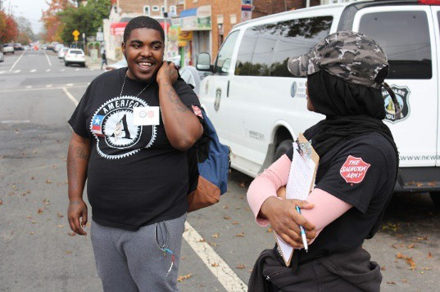
CONTACT INFORMATION
NJ Commission on National and Community Services NJ Department of State
33 west State Street, 4th Floor PO Box 456
Trenton, NJ 08625-0456
AmeriCorps.NJ@sos.nj.gov

