Slide 1

PUBLIC HEALTH AMERICORPS NOTICE OF FUNDING OPPORTUNITY
2023/24
TECHNICAL ASSISTANCE SESSIONS
General T/A Session,
Tuesday, October 4, 2021, 10:00 am
Theory of Change T/A Session on Tuesday, October 11, 2022, 10:00 am

Slide 2
About Public Health AmeriCorps
Public Health AmeriCorps will invest $400 million, over five years, from the American Rescue Plan Act workforce funding that will enable the recruitment, training, and development of a new generation of public health leaders who are ready to respond to the public health needs of the nation by providing public health service in communities.

Slide 3
Public Health AmeriCorp’s two main goals:
Goal 1:
Help meet public health needs of local communities by providing needed capacity and support in state and local public health settings and advancing more equitable health outcomes for communities who are currently or historically underserved.

Slide 4
Public Health AmeriCorp’s two main goals:
Goal 2:
Provide pathways to good, quality public health-related careers by providing exposure through onsite experience, training, and more, with a focus on recruiting AmeriCorps members who reflect the communities in which they will serve.

Slide 5
3 Priorities for this funding opportunity are:
  Efforts to help local communities respond to and recover from the COVID-19 pandemic. Applicants may propose programming to aid communities in their efforts to recover from the COVID-19 pandemic, including public health challenges that have been exacerbated by the pandemic, such as mental health and substance abuse.

Slide 6
3 Priorities for this funding opportunity are (cont’d):
Programs creating pathways to good-quality public health-related careers through onsite experience and training (including pre-apprenticeship or registered apprenticeship programs, work experience and job training programs, and other workforce training and development programs),
Organizations leading service in communities with concentrated poverty, rural communities, tribal communities, and those organizations serving historically underrepresented and underserved individuals, including but not limited to communities of color, immigrants and refugees, people with disabilities, people who identify as part of the LGBTQIA+ community, people with arrest and/or conviction records, and religious minorities.

Slide 7
Examples of roles that AmeriCorps member activities include:
  Community outreach
  Health education
  Mental health education and awareness, emotional regulation skill building
  Health and social services navigation
  Crisis response (e.g. COVID, Opioids, suicide, mental health)
  Capacity building

Slide 8
DATE | ACTIVITY
September 20-21 | Dissemination of NOFO flyer announcing the 2023/24 Public Health AmeriCorps Grants competition. NOFO goes live on the NJ Department of State website
October 4 | PHA NOFO Technical Assistance Session via ZOOM. Live at 10:00 am. Register here to attend the live session. Session will be recorded and available at the NJ Department of State AmeriCorps grants website within 24 hours.
October 11 | Technical Assistance Session on Theory of Change, Evidence, Logic Models and Performance Measures via ZOOM. 10:00 am. Register here to attend the session. Recorded session will be posted on NJ DOS website within 24 hours.
November 9 | Notice of Intent to Apply due to Commission. Click Notice of Intent to Apply to submit form.
November 17 | Public Health AmeriCorps applications due to Commission on eGrants by 4:00 pm.
November 21 | CREEHS and Staff review of applications and budgets are begun
December 8 or 9 | Reader Arena Session via ZOOM. Arena scores and final rankings.
December 13 | Notification of PHA applicants selected at Commission level and Reader/CREEHS revisions requested for applications recommended for funding
December 19 | Final revisions from applicants due back in eGrants
December 20 | Final staff review on revisions
December 21 | NJ Commission board vote on selected applicants
December 29 | NJ Commission target date for submission of Public Health AmeriCorps package to AmeriCorps (NOFO due date is January 4).
Mid-April 2023 | Successful national competition applicants will be notified
Mid-July 2023 | Commissions with successful applicants will be issued awards. Commissions will issue awards to sub-grantees for August 1, 2023 start date

Slide 9
NOFO Sections
Section I: NJ Commission Grant Information and Timelines
Section II: 2023 ASN Public Health AmeriCorps NOFO
Section III: 2023 Mandatory Supplemental Guidance
Section IV: ASN Application Instructions
Section V: Public Health Americorps Performance Measures
Section VI: Applicant Operational and Financial Management Survey (OFMS)

Slide 10
Performance Measures
All applications must include at least one aligned performance measure (output and outcome) that corresponds to the proposed primary intervention. This may be a National Performance Measure or an applicant-determined measure. See the Performance Measure Instructions for details about performance measure requirements and selection rules for PHA in the Index of the NOFO.

Slide 11
Organizations Eligible to Apply
Indian Tribes
institutions of higher education
local governments
public health departments
nonprofit organizations
state service commissions

Slide 12
Page Limitations
There are two sections with mandatory page limits: Narrative and Logic Model.
Applications must not exceed 10 pages for the Narrative or 12 pages for Rural Intermediaries.
In determining whether an application complies with page limits, the Corporation will count the following for the Narrative:
The application’s Executive Summary, SF 424 Facesheet, and The Narrative portions contained in the Program Design, Organizational Capacity, and Cost Effectiveness and Budget Adequacy sections of the application.
The Corporation strongly encourages applicants to print out the application from the “Review” tab prior to submission to check that the application does not exceed the page limit. The application page limit does not include the Budget, narrative portion of the Evaluation Plan, the Logic Model, performance measures, or the supplementary materials, if applicable.

Slide 13
Page Limitations
LOGIC MODEL
The Logic Model may not exceed three pages when printed with the application from the “Review” tab in eGrants.
Please note the length of a document in word processing software may be different than what will print out in the AmeriCorps' web-based system. Reviewers will not consider any submitted material that exceeds the page limits in the printed report, also, note that the system will not prevent an applicant from entering text that will exceed page limitations.
This applies to both the application page limit and the Logic Model page limit.

Slide 14
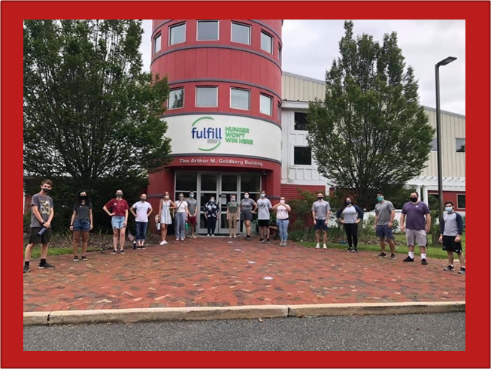
Funding Period
For New applicants, this is Year 1 of 2 of a multi-year grant period covering the following funding periods:
  Year 1: August 1, 2023 to July 31, 2024
  Year 2: August 1, 2024 to July 31, 2025

Slide 15

Notice of Intent To Apply
Applicants must fill out and submit the online Intent to Apply form by Wednesday, November 9, 2021, 4:00 p.m.
The following information is required:
  Organization Name
  Address
  Contact Name
  E-mail Address
  Phone Number
  Click here to complete:
  NOTICE OF INTENT TO APPLY form
  (The form can be also be found on our website)

Slide 16
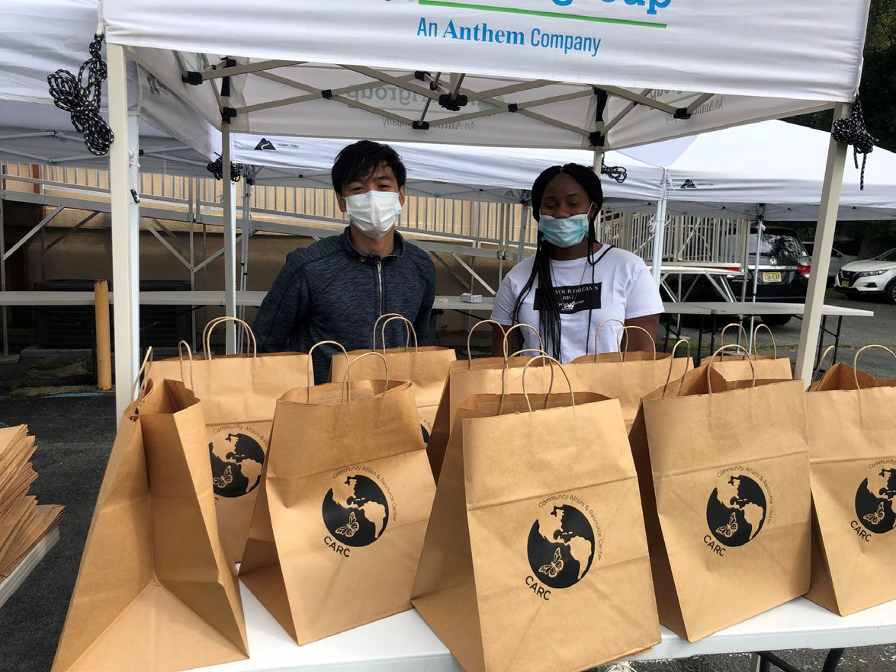
Applications must be submitted electronically on eGrants
NO LATER THAN
Thursday, November 17, 2022, 4:00 p.m.

Slide 17
Additional Documents
All documents that are requested in Section II: AmeriCorps NOFO need to be sent to the NJ Commission and not to AmeriCorps. The NJ Commission will forward additional documents to AmeriCorps upon selection of the application at the NJ level. Please see the PHA NOFO, Section I for further directions on submission of additional documents.
Applicants are required to submit the following additional documents by the application submission deadline:
  Financial Management Survey, Evaluation briefs (if applicable), reports, studies. Please refer to the Evidence Base section for detailed instructions by evidence tier.

Slide 18
. Unique Entity Identifier and System for Award Management (SAM)
All applicants must register with the System for Award Management (SAM) at https://www.sam.gov/SAM/ and maintain an active SAM registration until the application process is complete. AmeriCorps suggests that applicants finalize a new registration or renew an existing one at least three weeks before the application deadline, to allow time to resolve any issues that may arise. Applicants must use their SAMregistered legal name and physical address on all grant applications to AmeriCorps. The legal applicant’s name and physical address in eGrants must match exactly the applicant’s SAM-registered information.
Applications must include an Employer Identification Number. Applications must include a valid Unique Entity Identifier (UEI), which is generated as part of the SAM registration process

Slide 19
PART 2 Selection Criteria
Category | Percentage
Executive Summary | 0
Program Design Theory of Change & Logic Model Evidence Tier Evidence Quality Notice Priority Member Experience | Total 50% 24 points 12 points 8 points 0 points 6 points
Organizational Capability Organizational Background & Staffing Compliance and Accountability Member Supervision | Total 25% 13 points 8 points 4 points
Cost-Effectiveness and Budget Adequacy | Total 25%

Slide 20
Review Criteria (see Section II of NOFO)
A. Executive Summary (Required – 0%)
Please fill in the blanks of these sentences to complete the Executive Summary. Do not deviate from the template below.
The [Name of the organization] will have [Number of] AmeriCorps members who will [service activities the members will be doing] in [the locations the AmeriCorps members will serve]. At the end of the first program year, the AmeriCorps members will be responsible for [anticipated outcome of project]. In addition, the AmeriCorps members will leverage [number of leveraged volunteers, if applicable] who will be engaged in [what the leveraged volunteers will be doing.]
The AmeriCorps investment will be matched with $[amount of projected match], $[amount of local, state, and Federal Funds] in public funding and $[amount of non-governmental funds] in private funding.

Slide 21
Review Criteria (cont.)
B. Program Design (50%)
NOTE: The following information will be reviewed on the October 11 THEORY OF CHANGE SESSION
Theory of Change & Logic Model
Evidence Tier
Evidence Quality
24 pts. 12 pts.
8 pts.

Slide 22
Theory of Change and Logic Model (TOC) ( 24 points)
The TOC shall address:
The problem is prevalent and severe in communities where the program plans to serve and has been documented with relevant data.
The proposed intervention is responsive to the identified community problem.
The intervention is clearly articulated including the design, dosage, target population and roles of AmeriCorps members and (if applicable) leveraged volunteers.
The intervention is likely to lead to the outcomes identified in the TOC.

Slide 23
Theory of Change and Logic Model (TOC) ( 24 points) cont’d.
Outcomes in the narrative and logic model represent meaningful progress in addressing the community problem identified by the applicant.
The rationale for utilizing AmeriCorps members to deliver the intervention(s) is reasonable.
The service role of AmeriCorps members will produce significant contributions to existing efforts and help develop additional capacity to address the stated problem.

Slide 24
Theory of Change and Logic Model (TOC) ( 24 points) cont’d
The Logic Model Shall Depict:
A summary of the community problem, including the role current or historical inequities faced by underserved communities may play in contributing to the problem.
The inputs or resources that are necessary to deliver the intervention, including:
  Locations or sites in which members will provide services
  Number of AmeriCorps members who will deliver the intervention.
The core activities (interventions) or program model that members will implement or deliver, including:
  Duration of the intervention (# of weeks, sessions or months)
  Dosage of the intervention (# of hours per session or sessions per week)
  Target population for intervention (e.g., disconnected youth, 3rd graders at a certain reading level proficiency.

Slide 25
Theory of Change and Logic Model (TOC) ( 24 points) cont’d.
Logic Model (cont.)
The measurable outputs that result from delivering the intervention (i.e., number of beneficiaries served, types and numbers of activities conducted and equity gaps closed). If applicable, identify which National Performance Measures will be used as output indicators.
Outcomes that demonstrate changes in knowledge/skill, attitude, behavior, or condition that occur as a result of the intervention. If using National Performance Measures, indicate which.
NOTE: The Logic Model is a visual representation of the applicant’s Theory of Change (TOC). Programs should include short, medium, or long-term outcomes in the Logic Model. Applicants are not required to measure all components of their TOC. The applicant’s Performance Measures should be consistent with the program’s TOC and should represent significant program activities.

Slide 26
Theory of Change and Logic Model (TOC) ( 24 points) cont’d.
In the application narrative, applicants should discuss the community need as it relates to the CDC’s Social Vulnerability Index: https://www.atsdr.cdc.gov/placeandhealth/svi/index.html.
Also in the application narrative, applicants should discuss their rationale for setting output and outcome targets for their performance measures.
Rationales and justifications should be informed by the organization’s performance data (e.g., program data observed over time that suggests targets are reasonable), relevant research (e.g. targets documented by organizations running similar programs with similar populations), or prior program evaluation findings.
Applicants with multiple interventions should complete one Logic Model chart which incorporates each intervention. Logic Model content that exceeds three pages will not be reviewed.

Slide 27
Evidence Base (20 points)
The assessment of an applicant’s evidence base has two parts. First, the applicant will be assigned to an evidence tier (12 pts.) (see the Mandatory Supplemental Information found here.) Second, the quality (8 pts.) of the applicant’s evidence and the degree to which it supports the proposed program design, including program aligned with the priority areas identified above, will be assessed and scored.

Slide 28
Evidence Tier (12 points)
Evidence Tier (12 pts.)
An evidence tier will be assessed for each applicant for the purpose of understanding the relative strength of each applicant’s evidence base for their proposed public health service and public health workforce development intervention(s), and the likelihood that the proposed intervention (s) will lead to outcomes identified in the Logic Model.
Applicants who have outcome or impact evaluation reports of the same intervention described in the application (see Mandatory Supplemental Information found here for a definition of “same intervention”) may submit up to 2 of those reports, plus (if applicable) the evaluation report from their last three-year grant cycle, to qualify for the Preliminary, Moderate, or Strong evidence tier.

Slide 29
Evidence Tier (12 points) cont’d
In order to qualify for consideration, the intervention evaluated in the submitted report(s) must match the intervention proposed by the applicant in the following areas, all of which must be clearly described in the Program Design and Logic Model sections of the application:
Characteristics of the beneficiary population, including evidence of current or historic inequities facing the population;
Characteristics of the population delivering the intervention;
Dosage (frequency and duration) and design of the intervention, including all key components and activities;
The context in which the intervention is delivered; and
Outcome of the intervention.

Slide 30
Evidence Tier (12 points) cont’d
Submitted reports that do not sufficiently match the intervention proposed by the applicant in all of these areas will not be considered applicable and will not be reviewed or receive any points. Submission of additional documents that are not consistent with the guidance and requirements described in the Notice (e.g., advocacy pieces, policy briefs, other narratives that are not research studies or program evaluations) will not be reviewed.
In the Evidence Tier section of the application narrative, applicants must (1) summarize the study design and key findings of any outcome or impact evaluation report(s) submitted and (2) describe any other evidence that supports their program, including past performance measure data and/or other research studies that inform their program design. Applicants who submit evaluation reports for consideration must also describe in the Evidence Base section of the application narrative how the intervention described in the submitted reports is the same as the intervention described in the application (see Mandatory Supplemental Information found here).

Slide 31
Evidence Tier (12 points) cont’d
Applicants should provide citations for the studies they describe, if applicable; however, reviewers will not review any documents external to the application other than evaluation report(s) submitted in accordance with the Notice instructions.
Applicants must meet all requirements of an evidence tier in order to be considered for that tier.
If the evaluation reports submitted by the applicant do not meet the definitions in the Mandatory Supplemental Information, the applicant may be considered for a lower evidence tier.

Slide 32
Evidence Tier (12 points) cont’d
In 2022, the evidence tiers of successful AmeriCorps State and National Public Health AmeriCorps applicants that were competing were as follows:
  Strong 2%
  Moderate 2%,
  Preliminary 5%, and
  Pre-Preliminary 91%.
As these figures indicate, AmeriCorps values and funds programs at all points along the evidence continuum and expects programs to progress along the evidence continuum over time. Thus, do not be deterred from applying for funding due to your current evidence level.

Slide 33
Evidence Quality ( 8 points)
After the applicant’s evidence tier has been assessed, the quality of the applicant’s evidence and the extent to which it supports the proposed program design will be assessed and scored.
Applicants who are assessed as being in the Preliminary, Moderate, or Strong evidence tiers, reviewers will score the submitted evaluation reports using the following standards:
The submitted reports are of satisfactory methodological quality and rigor for the type of evaluation conducted (e.g., adequate sample size and statistical power, internal and/or external validity, appropriate use of control or comparison groups, etc.);
The submitted reports describe evaluations that were conducted relatively recently, preferably within the last six years;
The submitted reports show a meaningful and significant positive effect on program beneficiaries in at least one key outcome of interest.

Slide 34
Evidence Quality ( 8 points)
Applicants that are assessed as being in the Pre-Preliminary evidence tier, reviewers will score the narrative provided in the Evidence Base section of the application using the following standards:
  The applicant uses relevant evidence, including past performance measure data and/or cited research studies, to inform their proposed program design;
  The described evidence is relatively recent, preferably from the last six years;
  The evidence described by the applicant indicates a meaningful positive effect on program beneficiaries in at least one key outcome of interest.

Slide 35
AmeriCorps members’ service will provide them opportunities to develop as leaders
AmeriCorps members will gain skills as a result of their training and service that can be utilized and will be valued by future public health employers after their service term is completed.
AmeriCorps members receive additional benefits.
Member Experience (6 points)

Slide 36
Member Experience (6 points)
Description of the demographics of the community served and plans to recruit AmeriCorps members from geographic or demographic communities in which the program operates. This could include but not limited to the following historically underserved, under-represented, and disadvantaged populations of:
  communities of color
  LGBTQ+ (Lesbian, Gay, Bisexual, Transgender and Questioning) communities
  Individuals with varying degrees of English language proficiency
  Individuals with disabilities
  Veterans and military family members as volunteers

Slide 37
Member Experience (6 points)
Description of how the organization will ensure its project engages a diverse and inclusive group of members.
The applicant’s organization and/or program has a diversity, equity, and inclusion council or similar mechanism that seeks to diversity its staff and board and create a supportive and safe environment as well ensure that its programming is culturally and community appropriate.

Slide 38
Organizational Capability (25 points)
Organizational Background and Staffing (13 points)
The organization details the roles, responsibilities, and structure of the staff that will be implementing, providing oversight, and monitoring the program.
The organization has created pathways to good-quality public health-related careers through onsite experience and training (including pre-apprenticeship or registered apprenticeship programs, work experience and job training programs, and other workforce training and development programs),
The leadership and staff of the organization has the same lived experience as the beneficiary population and/or community being served.
The applicant’s (organization’s or institution’s) definitions of diversity, equity, inclusion, and accessibility demonstrate the organization is engaged in related to diversity, equity, and inclusion. This can include the inclusion of diversity on the Board of Directors, agency staff and leadership, and/or volunteers.

Slide 39
Organizational Capability (25 points)
Compliance and Accountability (8 points)
The extent to which the organization has a monitoring and oversight plan to prevent and detect non-compliance and enforce compliance with AmeriCorps rules and regulations including those related to prohibited activities and criminal history checks at the grantee, subgrantee (if applicable), and service site locations.
The extent to which the organization has an effective mechanism in place to report, without delay, any suspected criminal activity, waste, fraud, and/or abuse to both the AmeriCorps Office of Inspector General and AmeriCorps and a plan for training staff and participants on these reporting protocols.
The extent to which the organization has sufficient policies, procedures, and controls in place to prevent, detect, and mitigate the risk of fraud, waste, abuse, and mismanagement, this can include an assessment of appropriate segregation of duties, internal oversight activities, measures to prevent timekeeping fraud, etc.
The AmeriCorps-required evaluation report meets AmeriCorps requirements (if applicable).
The AmeriCorps-required evaluation report is of satisfactory quality (if applicable).

Slide 40
Organizational Capability (25 points)
4. Member Supervision (4 points)
AmeriCorps members will receive sufficient guidance and support from their supervisor to provide effective service.
AmeriCorps supervisors will be adequately trained/prepared to follow AmeriCorps and program regulations, priorities, and expectations.

Slide 41
Cost-Effectiveness and Budget Adequacy (25 pts.):
These criteria will be assessed based on the budget submitted. Do not include narrative in the narrative box except for “See budget”.
Budget complies with the Application Instructions found here (See Appendix B and C)
Applicant identifies sources of any additional revenue to support the program in the Source of Funds section of the budget (if applicable)
The cost per MSY is equal to or less than the maximum cost per MSY (See Section D.6.a.2). Proposed budgets that exceed the maximum cost per MSY will be considered unresponsive to the application criteria.

Slide 42
Important to your Budget
What is a Cost Per MSY?
Grant Program | Maximum
Traditional Cost Reimbursement | $28,800
Availability of Funds linked to enrollment and retention of awarded MSYs | No
Financial Reporting Requirements | Yes
The federal AmeriCorps grant is based on the number of MSY’s (or FTE’s) multiplied by $28,800
 EXAMPLE: An applicant requesting 10 full-time members may apply for a maximum of $288,000 and a program of 18 full- time members may apply for a maximum of $518,400.

Slide 43
Terms of Service and Living Allowance
Type of Member Position | Min. # of Hours | MSY | Min. Total Living Allowance | Max. Living Allowance
Full-time | 1700 | 1.000 | $17,600 | $35,200
Three Quarter-time | 1200 | 0.70 | $ 12,424 | $24,640
Half-time | 900 | 0.500 | $ 9,318 | $17,600
Reduced HT | 675 | 0.381 | $ 6,988 | $13,376
Quarter-time | 450 | 0.265 | $ 4,659 | $ 9,152
Minimum-time | 300 | 0.212 | $ 3,106 | $ 7,392
Abbreviated-time | 100 | 0.056 | $ 1,035 | $ 2,112

Slide 44
Program Manager Trainings and Meetings
Starting Strong – 3 days during end of July 2023
ASC Regional Training – 3 days
Other Training (e.g., Career Day, Site Supervisor Training) developed for members and project directors during the contract period.
Participate in all monthly conference calls or meetings.
In constructing the budget, figure in the cost for transportation, meals, and possible overnight accommodations related to all Corporation or Commission training sessions.

Slide 45
Statewide Corps Member Trainings and Events
All corps members and project directors are required to attend the following trainings/events:
  AmeriCorps Launch – October 2023
  End-of-the-Year Training – May or June 2024
  Other statewide training i.e., Career Day

Slide 46
Additional Application Resources
Please consult the AmeriCorps.gov website for tutorials, evidence checklist, logic model Instructions, frequently asked questions, AmeriCorps Terms and Conditions and other resources.
https://americorps.gov/funding-opportunity/fy-2023-americorps-state-national-grants
The full Regulations are available online at www.ecfr.gov

Slide 47
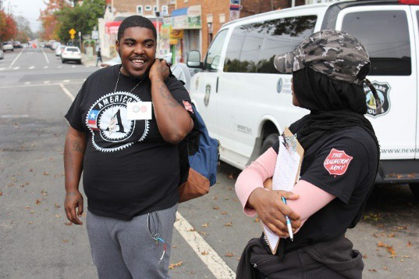
CONTACT INFORMATION
NJ Commission on National and Community Services NJ Department of State
33 west State Street, 4th Floor PO Box 456
Trenton, NJ 08625-0456
AmeriCorps.NJ@sos.nj.gov

