Slide 1

Formula Notice of Funding Opportunity
For Operating Grants
Technical Assistance Session
for 2025/26 Program Year
Friday, March 14, 2025

Slide 2
FORMULA NOFO SECTIONS
SECTION I: NJ COMMISSION GRANT INFORMATION AND TIMELINE (All Applicants)
SECTION II: PLANNING GRANT APPLICANTS (New Applicants Only)
SECTION III: OPERATING GRANT APPLICATION (Recompeting, Formula Fixed and Current Planning Grants)

Slide 3
SECTION I:
NJ COMMISSION GRANT INFORMATION AND TIMELINE
ALL APPLICANTS

Slide 4
DATES* | 25.26 ACNJ FORMULA GRANT ACTIVITIES
February 13 | Dissemination of NOFO flyer announcing the 2025/26 AmeriCorps Formula competition. NOFO goes live on the NJ Department of State (NJ DOS) website
March 6 | NOFO Technical Assistance Session – New via ZOOM. Live at 1:00 pm. Click title to register and receive link (good for all TA sessions). Mandatory for NEW applicants. (New Applicants are only eligible for Planning Grants)
March 13 | Technical Assistance Session: Evidence, Logic Models and Performance Measures via ZOOM. 11:00 am. Click title to register and receive link (good for all TA sessions). Mandatory for Recompete applicants. Strongly Recommended for New Applicants.
March 14 | NOFO Technical Assistance Session - General – CURRENT PLANNING GRANTS via ZOOM. Live at 11:00 am. Click title to register and receive link to attend. Recording of session will be posted on NJ DOS website. Mandatory for Recompete including current Planning grantees. This session will prepare applicants for the Formula 25.26 application. (2hrs)
March 17 | Notice of Intent to Apply due to Commission by 4:00 pm. Click title to submit form (NEW and RECOMPETING applicants only). For information only/not binding.
April 3 | Formula applications due to Commission on eGrants by 4:00 pm. (NEW and RECOMPETING Applicants only).
April 11 | Staff review of applications and budgets are begun (NEW & RECOMPETING)
April 14 | Technical Assistance session for Readers 1:00 pm via ZOOM. Independent reader review begins (NEW and RECOMPETING only)
April 15 | Formula applications due to Commission on eGrants by 4:00 pm. (Continuation Applicants only).
April 17 | Staff review of applications and budgets are begun (CONTINUATIONS ONLY)
April 30 | Reader Arena Session 1:00 pm via ZOOM. (New & Recompete only) Arena scores & final rankings. Notification of applicants selected pending final Commission Board vote.
May 8 | Revisions requested by staff are due back from applicants
May 12 | Commission board vote on selected applicants and continuations at 11:00 am
May 21 | NJ Commission target date for submission of Formula package to AmeriCorps.
TBD | Formula Applications due to AmeriCorps State and National

Slide 5
This Formula NOFO will fund the following types of grants:
PLANNING GRANTS: Planning Grants are available to agencies that are new to AmeriCorps. It provides funds for one year of planning and development of an infrastructure and application for an operating grant in the next program cycle. Planning grants do not include funds or slots for AmeriCorps members.
OPERATING GRANTS: Operating Grant funds are Cost Reimbursement Grants or Formula-Fixed Grants.
  Cost Reimbursement grants are available for programs that are currently in their third year of a three-year AmeriCorps program cycle. Operating grants are also available to applicants that have a current or prior planning grant. Funds are used for program operations and the living costs of a cadre of AmeriCorps members who will perform service.
  Formula-Fixed grants are operating grants that have completed one full three-year cycle of an operating grant. Formula Fixed grantees do not have to demonstrate a budget and match. However, in order to successfully operate the program, the applicant will need to provide additional resources.

Slide 6
Applicants must read the following corresponding sections to the type of program they are submitting:
NOFO Sections | Planning Grants | OPERATING GRANTS Cost Reimbursement or Formula Fixed
Section I: NJ Commission Grant Information & Timeline | X | X
Section II: Planning Grant Applications | X
Section III: Operating Grant Applications |  | X
Section IV: 2025 Mandatory Supplemental Information | X | X
Section V: 2025 AmeriCorps State and National Application Instructions | X | X
Section VI: 2025 AmeriCorps State and National Performance Measures |  | X
Section VII: Applicant Operational and Financial Management Survey (OFMS) | X | X

Slide 7
NOFO Application Focus Areas
Economic Opportunity
Education
Healthy Futures
Veterans and Military Families
Disaster Services
Environmental Stewardship

Slide 8
Economic Opportunity
Improving the economic well-being and security of underserved individuals.

Slide 9
Education
Improving educational outcomes for underserved people, especially children. AmeriCorps is particularly interested in program designs that support youth engagement and service learning as strategies to achieve high educational outcomes.

Slide 10
Healthy Futures
Support for health needs within communities, including mitigating the impacts of COVID19 and other public health crises, access to care, aging in place, and addressing childhood obesity, especially in underserved communities.

Slide 11
Veterans and Military Families
Improving the quality of life of veterans, military families, caregivers, and survivors.

Slide 12
Disaster Services
Helping individuals and communities prepare for, respond to, recover from, and mitigate the effects of disasters and increase community resiliency.

Slide 13
Environmental Stewardship
Supporting responsible stewardship of the environment, while preparing communities and helping Americans respond to/recover from disruptive events:
Programs that conserve natural habitats; protect clean air & water; maintain public lands; support wildland fire mitigation & sustainable forest management; cultivate individual and community resilience; and provide reforestation services after floods or fires, such as nature based solutions.
Including renewable energy & energy efficiency, building community resilience, sustainable food systems & agriculture, & conservation and habitat preservation

Slide 14
Organizational Eligibility to Apply
Eligibility is open to:
Indian Tribes
institutions of higher education
local governments
nonprofit organizations
state service commissions
states and US Territories

Slide 15
Estimated Award/Slot Amounts, MSY’s and
Period of Performance
 | Planning Grants | Cost Reimbursement or Formula Fixed Grants
Minimum MSY’s | 0 | 8 MSY’s
Maximum MSY’s | 0 | 15 MSY’s (Recompeting programs with 6 yrs. Of continuous funding may propose 18 MSY’s
Maximum Funding | Up to $85,000 | $378,000 (Recompeting programs with 6 yrs. Of continuous funding may apply for up to $453,600.
Period of Performance | One year – 9/1/25-8/31/26 | Three years – 9/1/25 – 8/31/28*

Slide 16
Electronic Application Submission in eGrants
Applicants must submit applications electronically via eGrants, AmeriCorps' web-based application system. AmeriCorps recommends that applicants create an eGrants account and begin the application at least three weeks before the deadline. Applicants should draft the application as a Word document, then copy and paste the text into the appropriate eGrants field no later than 10 days before the deadline.
The applicant’s authorized representative must be the person who submits the application. The authorized representative must use their own eGrants account to sign and submit the application. A copy of the governing body’s authorization for this official representative to sign must be on file in the applicant’s office.
Applicants should contact the AmeriCorps eGrants Hotline at (800) 942-2677 or via eGrants Questions if they have a problem when they create an account, prepare, or submit the application. AmeriCorps support hours vary by time of year, please check the site.

Slide 17
Application Content
  Complete applications must include the following elements:
  Standard Form 424 (SF-424) Face Sheet: This is automatically generated when applicants complete the data elements in the eGrants system.
  Narrative Sections:
      Executive Summary: This is a brief description of the proposed program.
      Program Design
      Organizational Capability
      Cost-Effectiveness & Budget Adequacy
  Logic Model
  Performance Measures
  Standard Form 424A Budget
  Continuation Changes – enter N/A in this field
  Clarification – enter N/A in this field
  Authorization, Assurances, and Certifications

Slide 18
Page Limitations
There are two sections with mandatory page limits: Narrative and Logic Model.
Applications must not exceed 11 pages (double-spaced) for the Narrative
In determining whether an application complies with page limits, the Commission will count the following for the Narrative:
The application’s Executive Summary, SF 424 Facesheet, and The Narrative portions contained in the Program Design, Organizational Capacity, and Cost Effectiveness and Budget Adequacy sections of the application.
The Cormmission strongly encourages applicants to print out the application from the “Review” tab prior to submission to check that the application does not exceed the page limit. The application page limit does not include the Budget, narrative portion of the Evaluation Plan, the Logic Model, performance measures, or the supplementary materials, if applicable.

Slide 19
Page Limitations
LOGIC MODEL The Logic Model may not exceed eight pages when printed with the application from the “Review” tab in eGrants.
Please note the length of a document in word processing software may be different than what will print out in the AmeriCorps' web-based system. Reviewers will not consider any submitted material that exceeds the page limits in the printed report, also, note that the system will not prevent an applicant from entering text that will exceed page limitations.
This applies to both the application page limit and the Logic Model page limit.

Slide 20
Notice of Intent to Apply
Submission of a Notice of Intent to Apply is requested and is due Monday, March 17, 2025 Please complete the online form: Notice of Intent to Apply for 25/26 AmeriCorps NJ Formula Funding
You will need to answer the following questions
  Address
  Contact Name
  E-mail address
  Phone Number
  Focus area your organization plans to address

Slide 21
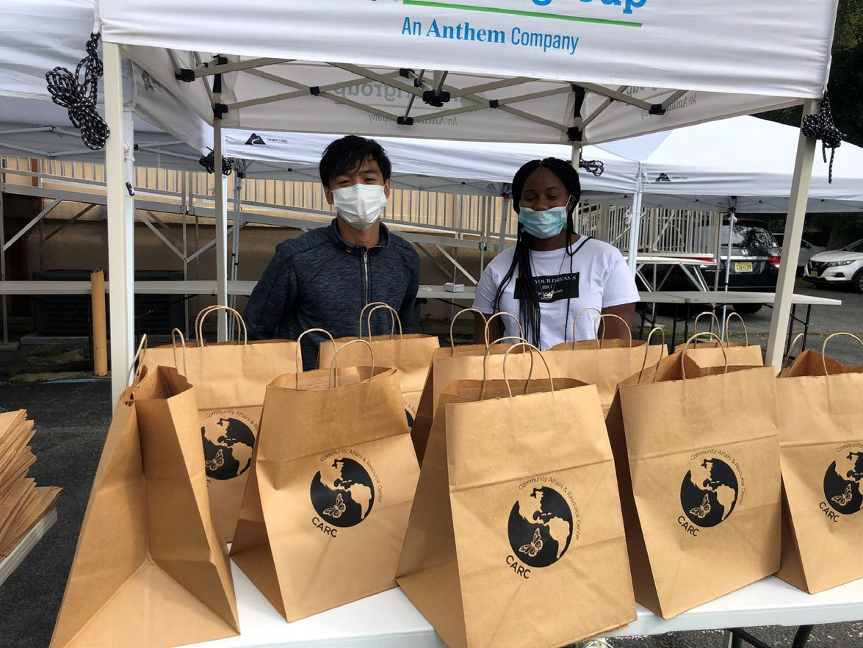
Applications must be submitted electronically on eGrants
NO LATER THAN
Thursday, April 3, 2025, 4:00 pm
(New and Recompeting Programs)
Tuesday , April 15, 2025, 4:00 pm (Continuation Programs)

Slide 22
Additional Documents
Applicants are required to submit the following additional documents by the application submission deadline:
  Online Financial Management Survey – all applicants
  Evaluation briefs, reports, studies. Please refer to the Evidence Base section for detailed instructions by evidence tier.
Additional documents must be emailed to AmeriCorps.NJ@sos.nj.gov with the following subject line: “Legal Applicant Name” – “Application ID Number.”
Please follow instructions in the Formula NOFO on how to submit additional documents.

Slide 23
Unique Entity Identifier and System for Award Management (SAM)
All applicants must register with the System for Award Management (SAM) at https://www.sam.gov/SAM/ and maintain an active SAM registration until the application process is complete. If an applicant is awarded a grant, it must maintain an active SAM registration throughout the life of the award. The Authorized Representative who signs the application must be registered as a Point of Contact or Alternate Point of Contact on the organization's SAM.gov account
Applicants must use their SAM registered legal name and physical address on all grant applications to AmeriCorps. The legal applicant’s name and physical address in eGrants must match exactly the applicant’s SAM-registered information.
Applications must include an Employer Identification Number.
Applications must include a valid Unique Entity Identifier (UEI), which is generated as part of the SAM registration process.

Slide 24
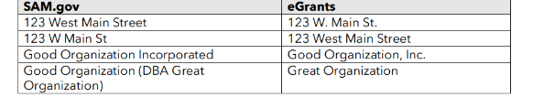
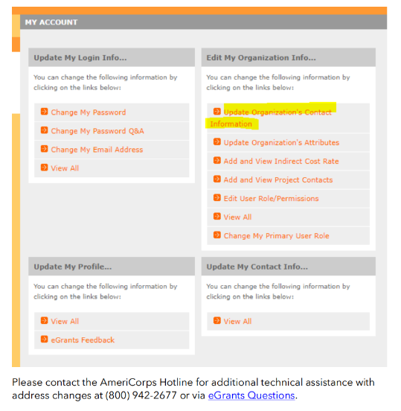
Example of Misalignment

Slide 25
SECTION III:
OPERATING GRANT APPLICATION
RECOMPETING AND CURRENT OR PRIOR PLANNING GRANT Applicants Only

Slide 26
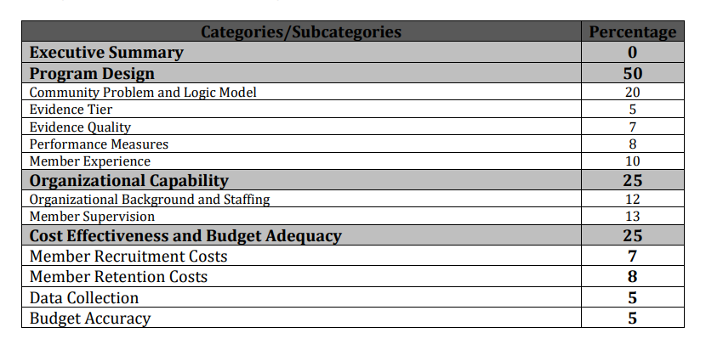
Operating Grant Selection Criteria

Slide 27
Review Criteria (see Section II of NOFO)
Executive Summary (Required - 0 percent)
Please fill in the blanks of these sentences to complete the Executive Summary. Do not deviate from the template below.
The [Name of the organization] proposes to have [Number of] AmeriCorps members who will [service activities the members will be doing] in [the locations the AmeriCorps members will serve]. At the end of the first program year, the AmeriCorps members will be responsible for [anticipated outcome of project]. In addition, the AmeriCorps members will leverage [number of leveraged volunteers, if applicable] who will be engaged in [what the leveraged volunteers will be doing.]
This program will focus on the AmeriCorps focus area(s) of [Focus Area(s)].* The AmeriCorps investment of $[amount of request] will be matched with $[amount of projected match], $[amount of local, state, and Federal funds] in public funding and $[amount of nongovernmental funds] in private funding.

Slide 28
Review Criteria (cont.)
NOTE: The following information was reviewed at the March 13th SESSION on Evidence, Logic Models and Performance Measures. Recording Posted to NJ Commission Website for your review.
Program Design (50 percent)
Reviewers will consider the quality of the application’s response to the criteria below. Do not assume all sub-criteria are of equal value.
Community Problem and Logic Model (20 points)
The applicant will provide a detailed summary of the community problem, including:
• How the applicant’s intervention(s) will lead to the outcomes identified in the
organization’s Logic Model
20 pts.
5 pts.
7 pts.
Community Problem & Logic Model
Evidence Tier
Evidence Quality

Slide 29
Community Problem & Logic Model (TOC)
(20 points) cont’d.
The applicant’s intervention is likely to lead to the outcomes identified in the organization’s Logic Model. No narrative is needed other than what is contained within the logic model.
The applicant will depict in the Logic Model:
The inputs or resources that are necessary to deliver the intervention, including but not limited to:
  Locations or sites in which members will provide services
  Context in which the intervention is delivered (e.g., the setting where the intervention is delivered)
  Number of AmeriCorps members who will deliver the intervention
  Characteristics of AmeriCorps members, including specific knowledge, skills, and abilities required to implement the intervention

Slide 30
Community Problem & Logic Model (TOC)
(20 points)
The core activities that define the intervention or program model that members will implement or deliver, including:
  Duration of the intervention (e.g., the total number of weeks, sessions or months of the intervention)
  Dosage of the intervention (e.g., the number of hours per session or sessions per week)
  Target population for the intervention (e.g., disconnected youth, third graders at a certain reading proficiency level)

Slide 31
Community Problem & Logic Model (TOC)
(20 points) cont’d.
Logic Model (cont.)
The measurable outputs that result from delivering the intervention (i.e., number of beneficiaries served, types and number of activities conducted, equity gaps closed). If applicable, identify which National Performance Measures will be used as output indicators.
Outcomes that demonstrate meaningful changes in knowledge/skill, attitude, behavior, or condition that occur as a result of the intervention. If applicable, identify which National Performance Measures will be used as outcome indicators.

Slide 32
Community Problem & Logic Model (TOC)
(20 points) cont’d.
Note: Programs should include short, medium, or long-term outcomes in the Logic Model. Applicants are not required to measure all components of their Logic Model. The applicant’s performance measures should be consistent with the program’s Logic Model and should represent significant program activities.
Rationales and justifications should be informed by the organization’s performance data (e.g., program data observed over time that suggests targets are reasonable), relevant research (e.g. targets documented by organizations running similar programs with similar populations), or prior program evaluation findings.
Applicants with multiple interventions should complete one Logic Model chart which incorporates each intervention. Logic Model content that exceeds eight pages will not be reviewed.

Slide 33
Evidence Base (12 points total)
The assessment of an applicant’s evidence base has two parts. First, the applicant will be assigned to an evidence tier for up to 5 points (use the Mandatory Supplemental Information). Second, for 7 points, the quality of the applicant’s evidence and the degree to which it supports the proposed program design will be assessed and scored.

Slide 34
Evidence Base (12 points total)
Evidence Tier (5 pts.)
An evidence tier will be assessed for each applicant for the purpose of understanding the relative strength of each applicant’s evidence base and the likelihood that the proposed intervention will lead to outcomes identified in the logic model.
In order to qualify for consideration, the intervention evaluated in the submitted report(s) must match the intervention proposed by the applicant in the following areas
  Characteristics of the beneficiary population;
  Characteristics of the population delivering the intervention;
  Dosage (frequency and duration) and design of the intervention, including all key components and activities;
  The context in which the intervention is delivered; and
  Outcome of the intervention.

Slide 35
Evidence Base (12 points total)
Evidence Tier (5 pts.) cont’d.
For description of the Evidence Tiers, go to the Mandatory Supplemental Guidance.
Applicants that have been funded for more than six (6) consecutive years should not be applying for pre-preliminary tier. It is expected that by this time, the program can demonstrate, at a minimum, a preliminary tier of evidence.
NOTE: If you are a program that has been funded for six (6) or more consecutive years, and you do not have Preliminary or a higher tier of evidence, then you must include an explanation for why not and how you plan to generate Preliminary or a higher tier of evidence for FY25/26 Formula application.

Slide 36
Evidence Base (12 points total)
Evidence Quality (7 points)
Standards applied to assess quality of Preliminary, Moderate or Strong evidence:
  Methodology
  Relatively recent
  Meaningful and Positive Effect on Beneficiaries
  For Pre-Preliminary:
  Same except should include past performance measure data or cited research studies.

Slide 37
Performance Measures (8 points)
Performance measures identify all components included in the Logic Model
Performance measures provide for adequate and quality data collection including instruments.
Applicant describes a data collection schedule including collection of baseline data (data collection schedule is described in narrative).

Slide 38
Describe the rationale by which you selected the number of members and slot types for your program. Describe how you plan to conduct the onboarding process and orientation on the first day of service to your cadre of members. Include training topics to be included in the orientation, including training on Prohibited Activities.
AmeriCorps members, as a result of their service, will have opportunities to develop as leaders. Please describe leadership training, topics and timeline that will enable members to develop as leaders. Discuss opportunities they will have to take leadership roles through service, service events, and/or project development.
AmeriCorps members will gain skills as a result of their training and service that can be utilized and will be valued by future employers after their service term is completed. Please describe the career exploration to be provided for transitioning to Life after AmeriCorps.
Member Experience (10 points)

Slide 39
Member Experience (10 points) Cont.
• The program has a well-defined plan to recruit AmeriCorps members from the geographic or demographic communities in which the programs operate. Please describe your recruitment plan, recruitment sources, criteria for selection and interview process for your AmeriCorps members.
• Describe what a typical day will look like for your members. Discuss how you plan to manage your AmeriCorps members, your site supervisors and how regularly you will meet with your members--individually and as a group--to reflect on their service.

Slide 40
Organizational Capability (25 points)
Organizational Background and Staffing (12 points)
The organization details the roles, responsibilities, and structure of the staff that will be implementing the AmeriCorps program as well as providing oversight and monitoring for the program. A full-time dedicated program manager is required in most instances.
The organization has facilitated, partnered, or participated in educational or workforce development programs (i.e., pre-apprenticeship/registered apprenticeship, work experience and job training programs, etc.).
The applicant describes their organization’s mission and relevant experience in areas such as volunteer recruitment and management, community outreach, overcoming project implementation challenges, etc

Slide 41
Organizational Capability (25 points)
2. Member Supervision (13 pts.)
The applicant details how AmeriCorps members will receive sufficient guidance and support from their supervisor to provide effective service (e.g., structure for member supervision: cadence and format of supervisor/AmeriCorps member check-ins, member and supervisor opportunities to assess strengths and opportunities for growth, member training plan, etc.).
The applicant details how AmeriCorps supervisors will be adequately trained/prepared to follow AmeriCorps and program regulations, priorities, and expectations (e.g., structure for support of supervisors, training plan for supervisors related to supervision and AmeriCorps rules and regulations, cadence and format of AmeriCorps supervisors/their supervisors check ins, opportunities to assess strengthens and opportunities for growth of supervisors, etc.).

Slide 42
Cost Effectiveness and Budget Adequacy (25 points)
1. Member Recruitment (7 points)
The applicant provides a description of budget expenses to support successful recruitment of AmeriCorps members best suited to serve the community, for example from geographic or demographic communities in which the program operates.
2. Member Retention (8 points)
The applicant provides a description of budget expenses to support retention of AmeriCorps members (e.g., additional member benefits such as increasing above the minimum living allowance, supporting workforce pathways, certifications, coaching for members, resume building, individual benefit as well as community building, network building, member recognition, alumni programming, etc.).
3. Budget Alignment to Program Design (3 points)
The applicant’s budget is aligned to the program design outlined in the narrative, meaning activities discussed in the narrative are incorporated in the budget in the agency or applicant share.

Slide 43
Cost Effectiveness and Budget Adequacy (25 pts.)
Contd.
Data Collection (5 points)
• The applicant provides a description of budget expenses to support data collection, continuous improvement activities, and evaluation of the interventions and impact on the community and the member experience.
Budget Accuracy (5 points)
The following criteria will be assessed based on the budget detail submitted and not in this narrative.
  Budget is submitted without mathematical errors.
  Proposed costs are allowable, reasonable, and allocable to the award.
  Budget is submitted with adequate information to assess how each line item is
  calculated.
  Budget complies with the budget instructions.
  Member stipends comport with the amounts outlined in this NOFO.
  Match is submitted with adequate information to support the amount written in the budget.
  The budgeted match is equal to or more than the required match for the given
  program year.
  The budget identifies the costs for one FTE Program Director.
  The cost per MSY is equal to or less than the maximum cost per MSY of $25,200.

Slide 44

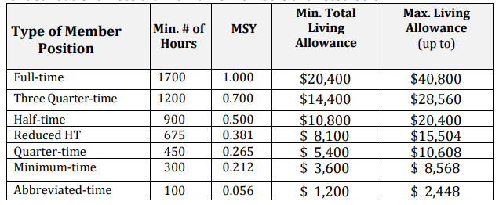

Slide 45


















Important to your Budget
Match Requirements Minimum Overall Share
Single overall minimum match of 24% for the first three-year cycle, match gradually increases every three years to 30% by year ten. Match may be cash or in-kind or a combination of both.

Slide 46
Important to your Budget
Budgeting Administration
Applicants may allocate administrative funds for their programs.
A portion or 1% - 2% of the administrative cap of 5% must be allocated for the NJ Commission according to the following:
Programs requesting 12 or less MSY’s do not have to allocate any portion of the administrative allowance to the Commission.
Programs requesting 13-17 MSY’s should allocate 1% of their administrative allowance to the Commission using this formula: Section I + Section II x 0.0526 x 0.20 = Commission Share
Programs requesting 18 or more MSY’s should allocate 2% of their administrative allowance to the Commission using this formula: Section I + Section II x 0.0526 x 0.40 = Commission Share

Slide 47
SUBMITTING YOUR APPLICATION
IN EGRANTS
Please follow directions in the 2025 Application Instructions. The link is in the Table of Contents of the Formula NOFO.

Slide 48
Program Manager Trainings and Meetings
Starting Strong – 3 days during end of July
ASC National Service Training – 3 days
Other Training (e.g., Career Day, Site Supervisor Training) developed for members and project directors during the contract period.
Participate in all monthly conference calls or meetings.
In constructing the budget, figure in the cost for transportation, meals, and possible overnight accommodations related to all Corporation or Commission training sessions.

Slide 49
Statewide Corps Member Trainings and Events
All corps members and project directors are required to attend the following trainings/events:
  AmeriCorps Launch – October
  End-of-the-Year Training – May or June
  Other statewide training i.e., Career Day

Slide 50
Additional Application Resources
Please consult the AmeriCorps.gov website for tutorials, evidence checklist, logic model Instructions, frequently asked questions, AmeriCorps Terms and Conditions and other resources.
The full Regulations are available online at www.ecfr.gov

Slide 51
CONTACT INFORMATION
NJ Commission on National and Community Services NJ Department of State
33 west State Street, 4th Floor PO Box 456
Trenton, NJ 08625-0456
AmeriCorps.NJ@sos.nj.gov

