Slide 1


AMERICORPS COMPETITIVE NOTICE OF FUNDING OPPORTUNITY
2025/26
General Technical Assistance Session,
Thursday, October 10, 2024,
10:00 am

Slide 2
FY25.26 COMPETITIVE NOFO GRANT APPLICATION TIMELINE
DATE | ACTIVITY
September 20 | Dissemination of NOFO flyer announcing the 2025/26 Competitive AmeriCorps Grants competition. NOFO goes live on the NJ DOS website: https://www.state.nj.us/state/volunteer-grant-opportunities.shtml
October 10 | General Technical Assistance Session via ZOOM. Live at 10:00 am. Register here to attend the live session. Session will be recorded and available at the NJ Department of State AmeriCorps grants website within 24 hours. Mandatory for Competitive applicants.
November 13 | Notice of Intent to Apply due to Commission. Form available here
November 27 | Competitive applications due to Commission on eGrants by 4:00 pm EST.
December 2 | Staff and Independent Readers review of applications and budgets are begun.
December 18 | Competitive Applications Reader Arena 11A via ZOOM. Arena scores and final rankings.
December 20 | Notification of Competitive Applicants selected for submission to national competition. Staff and reader revisions requested for applications recommended for national competition.
January 7 | Final revisions from applicants due back in eGrants.
January 9 | Final staff review on revisions.
January 10 | NJ Commission board vote on selected applicants.
January 17 | NJ Commission target date for submission of Competitive packages to AmeriCorps. (ASN due date is January 23)
Mid-April 2025 | Successful Competitive applicants to be notified by AmeriCorps National.
Mid-July 2025 | Successful Competitive applicants to be issued awards.

Slide 3
NOFO Sections
Section I: 2025 NJ Commission Grant Information and Timelines
Section II: 2025 AmeriCorps State and National NOFO
Section III: 2025 Mandatory Supplemental Guidance
Section IV: 2025 ASN Application Instructions

Slide 4
NOFO Sections
Section V: 2025 Performance Measures
Section VI: 2025 Applicant Determined Performance Measures Supplement and Suggested Applicant Determined Performance Measures for Native Nations and Bridge Building.
Section VII: 2025 PHA Performance Measures Public Health
NOTE: Links to Sections II – VII are available in the NOFO Section I and also at the end of the Section I NOFO.

Slide 5
Changes from the prior year’s Competitive NOFO
Increased minimum living allowance for FT members to $20,400
Increased maximum living allowance for all members ($40,800 FT)
Updated Funding Priority areas
Updated match schedule to max 30%
Additional document submission updates
Opportunity for reconsideration of funding — 5 business days
Changes in criteria scoring
Mandatory Supplemental Information – added definitions for:
  Disadvantaged youth
  Economically disadvantaged
  Public Health AmeriCorps priority
  Second chance youth
  Slot Types

Slide 6
Changes from the prior year’s Competitive NOFO
Application Instructions Section Changes/Additions
  Additional Document questions for all.
  Parameters for file size submission
  Single audit requirements for over $1,000,000
  Carry forward worksheet for unexpended known now or post-award
  Clarified state commission subapplicants are not to budget for symposium
  Equipment updated to $10,000
  Health-care for non-full-time changed to “non-AmeriCorps” sources
  De Minimis updated to 15% (from 10%)
  Alternative match schedule being phased out during FY24, unavailable for FY25
  Match waiver criteria updating 10/1/2024

Slide 7
NOFO Application FOCUS Areas for Performance Measures
Economic Opportunity
Education
Healthy Futures
Veterans and Military Families
Disaster Services
Environmental Stewardship

Slide 8
Funding Priorities
AmeriCorps will target its investments toward communities where the need is greatest, particularly those with populations that face racial inequality and poverty.
AmeriCorps’s priorities for this funding opportunity are as follows:

Slide 9
Funding priorities
Serve Communities: Serve communities with concentrated poverty, rural communities, tribal communities, and historically underrepresented and underserved individuals. These may include people of color, immigrants, refugees, people with disabilities, LGBTQIA+ individuals, people with arrest or conviction records, religious minorities, etc.;
Implement programs for or expand access to high-quality youth mental health and substance use recovery services and prepare AmeriCorps members to enter behavioral health careers. These may include individuals with lived experience with substance use and mental health challenges to support youth mental health efforts and continued AmeriCorps work on the opioid epidemic;

Slide 10
Funding priorities (cont.)
Focus on improving the quality of life for veterans, active-duty members of the Armed Forces, and their families by recruiting veterans, military spouses, and their older children into national service;
Promote environmental stewardship to help communities (especially underserved households and communities) to be more resilient by reducing greenhouse gas emissions, conserving land and water, increasing renewable energy use and improving at-risk ecosystems;

Slide 11
Funding priorities (cont.)
Support civic bridge-building programs and projects to reduce polarization and community divisions; and providing training in civic bridge-building skills and techniques to AmeriCorps members.
Benefit AmeriCorps Members:
Provide benefits to AmeriCorps members aimed at enhancing member experience and bolstering member recruitment and retention such as paying more than the minimum living allowance, transportation, housing, food, etc.;
Create workforce pathways for AmeriCorps members, including deliberate training, certifications, and hiring preferences or support;
Enhance and expand services to second chance youth and/or engage those youth as AmeriCorps members;

Slide 12
Funding priorities (cont.)
Develop and train the next generation of diverse public health leaders through service while addressing pressing community health challenges. Review Public Health AmeriCorps Priority in the Mandatory Supplemental Information for eligibility information;
Use Evidence Utilize reports from the AmeriCorps Evidence Exchange on programs assessed as having Moderate or Strong evidence to scale, replicate, or adapt the intervention;
Faith-Based
Organizations that are faith-based.

Slide 13
Funding priorities (cont.)
American Climate Corps
  Please note that applicants may propose projects to be affiliated with the American Climate Corps (ACC), which is a federal government national service and workforce development initiative focused on training young people for the clean energy and climate resilience workforce. Applicants who are interested must demonstrate that their project funds ACC eligible positions meeting the following criteria:
      The position has verifiable climate or environmental impact.
      The position is temporary (term-limited), and the term length is at least 300 hours.
      The position includes skills-based training as part of the program and provides a pathway to employment.
      The position must receive a living allowance and, in some cases, may receive additional member benefits.

Slide 14
Funding priorities (cont.)
Applicants submitting a workforce development project to qualify for affiliation with the ACC should note that in their application. Successful applicants will be notified if they are part of the ACC and may be subject to additional reporting requirements.
To receive priority consideration, applicants must show that the priority area is a significant part of the program focus and intended outcomes. Proposing programs that receive priority consideration does not guarantee funding.

Slide 15
Performance Measures
All applications must include at least one aligned performance measure (output and outcome) that corresponds to the proposed primary intervention.
This may be a National Performance Measure or an applicant-determined measure.
See the Performance Measure Instructions for details about performance measure requirements and selection rules.

Slide 16
Determine Type of Program
REGULAR COST REIMBURSEMENT
  Funds a portion of program costs and members’ living allowance.
PROFESSIONAL CORPS
  Professional Corps programs place professionals in communities where there is a documented shortage of such professionals.
  Stipends/salaries are paid by other organizations.
  Can be either cost reimbursement or fixed-amount.
FULL COST FIXED-AMOUNT GRANTS (Only available for recompeting applications)
  Applicants apply for a fixed amount per MSY* & use their own or other resources for the remaining cost of the program. No match requirements, but the program must still raise the additional funds needed to run the program.
  *MSY = Member Service Year

Slide 17
Organizational Eligibility to Apply
Eligibility is open to:
Indian Tribes
institutions of higher education
local governments
nonprofit organizations
state service commissions
states and US Territories

Slide 18
Page Limitations
There are two sections with mandatory page limits: Narrative and Logic Model.
Applications must not exceed 10 pages for the Narrative.
In determining whether an application complies with page limits, ASN will count the following for the Narrative:
The application’s Executive Summary, SF 424 Facesheet, and The Narrative portions contained in the Program Design, Organizational Capacity, and Cost Effectiveness and Budget Adequacy sections of the application.
ASN strongly encourages applicants to print out the application from the “Review” tab prior to submission to check that the application does not exceed the page limit. The application page limit does not include the Budget, narrative portion of the Evaluation Plan, the Logic Model, performance measures, or the supplementary materials, if applicable.

Slide 19
Page Limitations
LOGIC MODEL
The Logic Model may not exceed eight pages when printed with the application from the “Review” tab in eGrants.
Please note the length of a document in word processing software may be different than what will print out in the AmeriCorps' web-based system.
Reviewers will not consider any submitted material that exceeds the page limits in the printed report, also, note that the system will not prevent an applicant from entering text that will exceed page limitations.
This applies to both the application page limit and the Logic Model page limit.

Slide 20
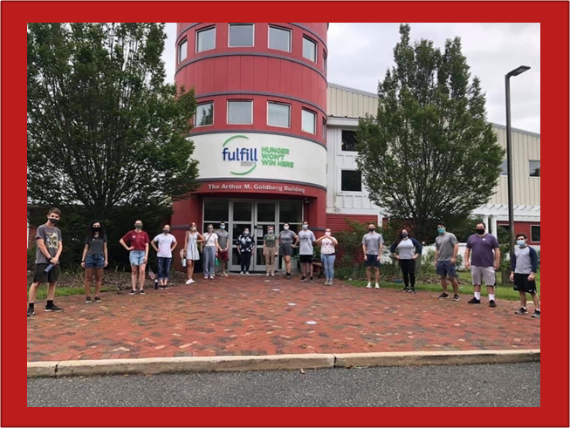
Funding Period
For New or Re-competing applications, this is Year 1 of 3 of a multi-year grant period covering the following funding periods:
  Year 1 September 1, 2025 to August 31, 2026
  Year 2 September 1, 2026 to August 31, 2027
  Year 3 September 1, 2027 to August 31, 2028

Slide 21

Notice of Intent To Apply
Applicants must fill out and submit the online Intent to Apply form by Wednesday, November 13, 2024, 4:00 p.m.
The following information is required:
  Organization Name
  Address
  Contact Name
  E-mail Address
  Phone Number
  Focus area/s application will address
  Applying as New or Continuation
  Click here to complete:
  NOTICE OF INTENT TO APPLY form
  (The form can be also be found on our website)

Slide 22
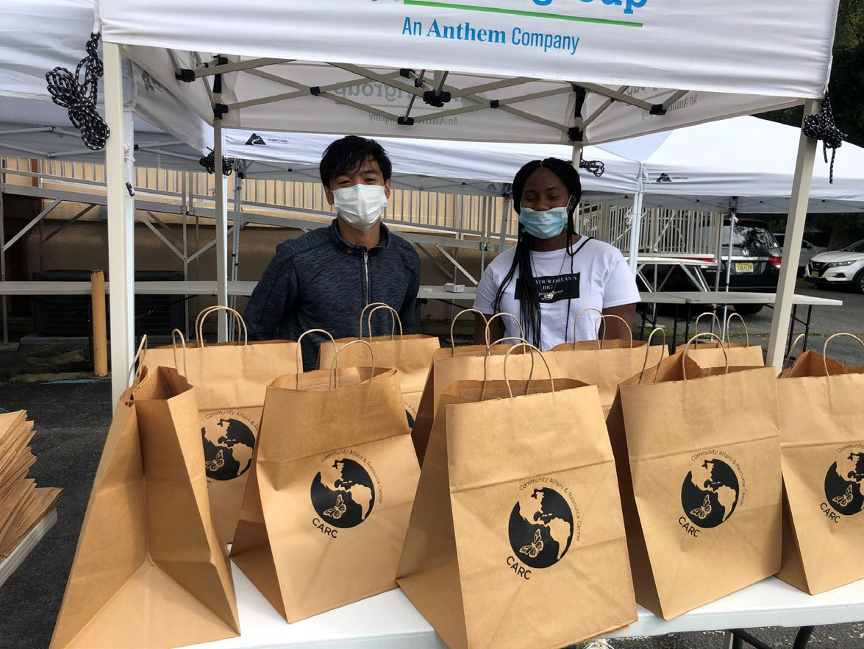
Applications must be submitted electronically on eGrants
NO LATER THAN
Wednesday, November 27, 2024, 4:00 p.m.

Slide 23
Additional Documents
All documents that are requested in Section II: AmeriCorps NOFO need to be sent to the NJ Commission and not to AmeriCorps. The NJ Commission will forward additional documents to AmeriCorps upon selection of the application at the NJ level.
Please send the documents to AmeriCorps.NJ@sos.nj.gov
Please refer to Section II, D.7.b for a list of additional documents that will need to be submitted.

Slide 24
Unique Entity Identifier and System for Award Management (SAM)
All applicants must register with the System for Award Management (SAM) at https://www.sam.gov and maintain an active SAM registration until the application process is complete. If an applicant is awarded a grant, it must maintain an active SAM registration throughout the life of the award.
Applicants must use their SAM registered legal name and physical address on all grant applications to AmeriCorps. The legal applicant’s name and physical address in eGrants must match exactly the applicant’s SAM-registered information.
Applications must include an Employer Identification Number.
Applications must include a valid Unique Entity Identifier (UEI), which is generated as part of the SAM registration process.

Slide 25
PART 3 Selection Criteria
Category | Percentage
Executive Summary | 0
Program Design Community & Logic Model Evidence Tier Evidence Quality Notice Priority Member Experience | Total 50% 24 points 12 points 8 points 0 points 6 points
Organizational Capability Organizational Background & Staffing Member Supervision Commitment to Diversity, Equity, Inclusion, and Accessibility | Total 25% 15 points 6 points 4 points
Cost-Effectiveness and Budget Adequacy Member Recruitment Member Retention Data Collection | Total 25% 8 points 9 points 8 points

Slide 26
Review Criteria (see Section II of NOFO)
A. Executive Summary (Required – 0%)
Please fill in the blanks of these sentences to complete the Executive Summary. There are two options for the second paragraph; please choose the appropriate language for your application. Do not deviate from this template:
  “The [Name of the organization] will have [Number of] AmeriCorps members in [the locations the AmeriCorps members will serve, e.g. – City, State or State(s)]. AmeriCorps members will [service activities the members will do]. At the end of the first program year, the AmeriCorps members will be responsible for [anticipated outcome of project]. In addition, the AmeriCorps members will leverage [number of leveraged volunteers, if applicable] who will be engaged in [what the leveraged volunteers will be doing].

Slide 27
Review Criteria (see Section II of NOFO)
A. Executive Summary (Required – 0%) cont.
Cost Reimbursement grant applicants:
The AmeriCorps investment will be matched with $[amount of projected match], $[amount of local, state, and Federal Funds] in public funding and $[amount of non-governmental funds] in private funding.”
Fixed amount grant applicants e.g., EAP, Full-Cost Fixed, No Cost Slots:
In addition to the AmeriCorps investment, $[amount of local, state, and Federal Funds] in public funding and $[amount of non-governmental funds] in private funding will support the project.”

Slide 28
Community and Logic Model ( 24 pts)
The applicant will provide a detailed summary of the community problem, including:
    How the inequities faced by underserved communities may contribute to the problem.
    How the CDC’s Social Vulnerability Index explains the extent of the problem.
    How the applicant’s intervention(s) will lead to the outcomes identified in the organization’s Logic Model.

Slide 29
Community and Logic Model ( 24 points) cont’d.
The applicant will depict in the Logic Model:
  The inputs or resources that are necessary to deliver the intervention, including but not limited to:
  Locations or sites in which members will provide services.
  Setting and community condition where the intervention is delivered.
  Number of AmeriCorps members who will deliver the intervention.
  Characteristics of AmeriCorps members, including specific knowledge, skills, and abilities required to implement the intervention.

Slide 30
Community and Logic Model ( 24 points) cont’d
The Logic Model Shall Depict (cont.):
The core activities that define the intervention or program model that members will implement or deliver, including:
  Length of each activity (e.g., the total number of weeks, sessions or months of the intervention)
  Dosage of each activity (e.g., the number of hours per session or sessions per week)
  Target population for the intervention (e.g., disconnected youth, third graders at a certain reading proficiency level)
The measurable outputs that result from delivering the intervention (i.e., number of beneficiaries served, types and number of activities conducted, equity gaps closed). If applicable, identify which National Performance Measures will be used as output indicators.

Slide 31
Community and Logic Model ( 24 points) cont’d
Outcomes that result from the intervention, including meaningful changes in knowledge/skill, attitude, behavior, or condition. If applicable, identify which National Performance Measures will be used as outcome indicators.
Programs should include short, medium, or long-term outcomes. Applicants are not required to measure all components of their Logic Model. The applicant’s performance measures should be consistent with the program’s Logic Model and should represent significant program activities.
Applicants with multiple interventions should include the above information for each intervention in the logic model.

Slide 32
Evidence Base (20 pts)
The assessment of an applicant’s evidence base has two parts.
First, the applicant will be assigned to an evidence tier.
Second, the quality of the applicant’s evidence and the degree to which it supports the proposed program design, including program aligned with the priority areas identified above, will be assessed and scored.

Slide 33
Evidence Tier (12 points)
Evidence Tier (12 pts.)
An evidence tier will be assessed for each applicant for the purpose of understanding the relative strength of each applicant’s evidence base and the likelihood that the proposed intervention will lead to outcomes identified in the logic model.
Applicants who have outcome or impact evaluation reports of the same intervention described in the application (see Mandatory Supplemental Information found here for a definition of “same intervention”) may submit up to 2 of those reports, plus (if applicable) the evaluation report from their last three-year grant cycle, to qualify for the Preliminary, Moderate, or Strong evidence tier.

Slide 34
Evidence Tier (12 points)
In 2023, the evidence tiers of successful AmeriCorps State and National applicants that were competing were as follows: Strong 25 percent, Moderate 12 percent, Preliminary 20 percent, and Pre-Preliminary 43 percent. As these figures indicate, AmeriCorps values and funds programs at all points along the evidence continuum and expects programs to progress along the evidence continuum over time. Thus, applicants should not be deterred from applying for funding due to their current evidence level.

Slide 35
Evidence Tier (12 points)
In order to qualify for consideration, the intervention evaluated in the submitted report(s) must match the intervention proposed by the applicant in the following areas, all of which must be clearly described in the Community and Logic Model sections of the application.
  Characteristics of the beneficiary population, including evidence of current or historic inequities facing the population;
  Characteristics of the population delivering the intervention;
  Dosage (frequency and duration) and design of the intervention, including all key components and activities;
  The context in which the intervention is delivered; and
  Outcome of the intervention.

Slide 36
Evidence Tier (12 points) cont’d
Submitted reports that do not sufficiently match the intervention proposed by the applicant in all of these areas will not be considered applicable and will not be reviewed or receive any points.
Submission of additional documents that are not consistent with the guidance and requirements described in the Notice (e.g., advocacy pieces, policy briefs, other narratives that are not research studies or program evaluations) will not be reviewed.

Slide 37
Evidence Tier (12 points) cont’d
In the Evidence Tier section of the application narrative, applicants must
(1) summarize the study design and key findings of any outcome or impact evaluation report(s) submitted and
(2) describe any other evidence that supports their program, including past performance measure data and/or other research studies that inform their program design.
Applicants who submit evaluation reports for consideration must also describe in the Evidence Base section of the application narrative how the intervention described in the submitted reports is the same as the intervention described in the application (see Mandatory Supplemental Information found here.)

Slide 38
Evidence Tier (12 points) cont’d
Applicants should provide citations for the studies they describe, if applicable; however, reviewers will not review any documents external to the application other than evaluation report(s) submitted in accordance with the Notice instructions.
Applicants must meet all requirements of an evidence tier in order to be considered for that tier.
If the evaluation reports submitted by the applicant do not meet the definitions in the Mandatory Supplemental Information, the applicant may be considered for a lower evidence tier

Slide 39
Evidence Quality ( 8 points)
After the applicant’s evidence tier has been assessed, the quality of the applicant’s evidence and the extent to which it supports the proposed program design will be assessed and scored.

Slide 40
Evidence Quality ( 8 points) cont’d
Applicants who are assessed as being in the Preliminary, Moderate, or Strong evidence tiers, reviewers will score the submitted evaluation reports using the following standards:
The submitted reports are of satisfactory methodological quality and rigor for the type of evaluation conducted (e.g., adequate sample size and statistical power, internal and/or external validity, appropriate use of control or comparison groups, etc.);
The submitted reports describe evaluations that were conducted relatively recently, preferably within the last six years;
The submitted reports show a meaningful and significant positive effect on program beneficiaries or AmeriCorps members in at least one key outcome of interest.

Slide 41
Evidence Quality (8 points) cont’d
Applicants that are assessed as being in the Pre-Preliminary evidence tier, reviewers will score the narrative provided in the Evidence Base section of the application using the following standards:
The applicant uses relevant evidence, including past performance measure data and/or cited research studies, to inform their proposed program design;
The described evidence is relatively recent, preferably from the last six years;
The evidence described by the applicant indicates a meaningful positive effect on program beneficiaries or AmeriCorps members in at least one key outcome of interest.

Slide 42
AmeriCorps members’ service will provide them opportunities to develop as leaders.
AmeriCorps members will gain skills as a result of their training and service that can be utilized and will be valued by future employers after their service term is completed.
AmeriCorps members receive additional benefits.
Member Experience (6 points)

Slide 43
Member Experience (6 points)
The applicant details how AmeriCorps members will be provided an opportunity to be leaders and gain skills during their term of service that will be valued by future employers (e.g., workforce pathways, increasing levels of responsibility and leadership roles for members).
The applicant details how AmeriCorps members will be provided a high quality orientation to the community they will serve in that is from an asset based frame and guided and informed by the community.

Slide 44
Organizational Capability (25 points)
Organizational Background and Staffing (15 points)
  The applicant details the roles, responsibilities, and structure of the staff that will be implementing, providing oversight, and monitoring the program.
  The applicant has facilitated, partnered, or participated in educational or workforce development programs (i.e., pre-apprenticeship/registered apprenticeship, work experience and job training programs, etc.)
  The applicant describes their organization’s mission and relevant experience in areas such as volunteer recruitment and management, community outreach, overcoming project implementation challenges, etc.

Slide 45
Organizational Capability (25 points)
2. Member Supervision (6 points)
The applicant details how AmeriCorps members will receive sufficient guidance and support from their supervisor to provide effective service (e.g., structure for member supervision: cadence and format of supervisor/AmeriCorps member check-ins, member and supervisor opportunities to assess strengths and opportunities for growth, member training plan, etc.).
The applicant details how AmeriCorps supervisors will be adequately trained/prepared to follow AmeriCorps and program regulations, priorities, and expectations (e.g., structure for support of supervisors, training plan for supervisors related to supervision and AmeriCorps rules and regulations, cadence and format of AmeriCorps supervisors/their supervisors check ins, opportunities to assess strengthens and opportunities for growth of supervisors, etc.).

Slide 46
Organizational Capability (25 points)
3. Commitment to Diversity, Equity, Inclusion, and Accessibility (4 points)
The leadership and staff of the organization have similar lived experience as the beneficiary population and/or community being served.
The applicant’s definitions of diversity, equity, inclusion, and accessibility is demonstrated by the organization (e.g., diversity on the Board of Directors, agency staff and leadership, and/or volunteers) and the organization upholds a supportive and safe environment for individuals of diverse backgrounds.

Slide 47
Cost Effectiveness & Budget Adequacy (25 percent)
1. Member Recruitment (7 points)
The applicant provides a description of budget expenses to support successful recruitment of AmeriCorps members best suited to serve the community, for example from geographic or demographic communities in which the program operates.
2. Member Retention (8 points)
The applicant provides a description of budget expenses to support retention of AmeriCorps members (e.g., additional member benefits such as increasing above the minimum living allowance, supporting workforce pathways, certifications, coaching for members, resume building, individual benefit as well as community building, network building, member recognition, alumni programming, etc.).

Slide 48
Cost Effectiveness & Budget Adequacy (25 percent) cont’d
3. Data Collection (7 points)
The applicant provides a description of budget expenses to support data collection, continuous improvement activities, and evaluation in service to evaluating the interventions and impact on the community and the member experience).
4. Budget Alignment to Program Design (3 points)
The applicant’s budget is aligned to the program design outlined in the narrative, meaning activities discussed in the narrative are incorporated in the budget in the agency or applicant share.

Slide 49
E. Evaluation Summary or Plan
(Required for recompeting grantees – 0 points)
.
If the applicant has previously received three or more years of competitive funding for the same project being proposed (use the Mandatory Supplemental Information for the AmeriCorps definition of “same project”), the applicant must submit an evaluation plan as an attachment (use the D.7.b Submission of Additional Documents section for more information).
If the applicant has previously received six or more years of competitive funding for the same project being proposed, the applicant must submit both an evaluation plan and an evaluation report as attachments.

Slide 50
E. Evaluation Summary or Plan
(Required for recompeting grantees – 0 points)
Applicants should use the evaluation plan template found on the Notice webpage to craft their evaluation plans. The template document provides detailed information about the AmeriCorps evaluation requirements (45 CFR 2522.700 -.710)and specifies the information that must be provided for the evaluation plan to be approved by AmeriCorps.
The evaluation plan will not be scored and will not be reviewed until after funding decisions have been made.
All applicants should enter “N/A” in the “Evaluation Summary or Plan” field of the Narrative. Any other text entered in this field will not be reviewed.

Slide 51
Important to your Budget
What is a Cost Per MSY?
Grant Program | Maximum
Traditional Cost Reimbursement | $25,000
Professional Corps | Up to $1,000
Professional Corps Fixed Amount Grants | Up to $1,000
Full Cost Fixed Amount Grants | $25,000
The federal AmeriCorps grant is based on the number of MSY’s (or FTE’s) multiplied by $25,000
EXAMPLE: An applicant requesting 10 full-time members may apply for a maximum of $250,000 and a program of 18 full- time members may apply for a maximum of $450,000.

Slide 52

Type of Member Position | Min. # of Hours | MSY | Min. Total Living Allowance | Max. Living Allowance
Full-time | 1700 | 1.000 | $20,400 | $40,800
Three Quarter-time | 1200 | 0.700 | $ 14,400 | $28,560
Half-time | 900 | 0.500 | $ 10,800 | $20,400
Reduced HT | 675 | 0.381 | $ 8,100 | $15,504
Quarter-time | 450 | 0.265 | $ 5,400 | $10,608
Minimum-time | 300 | 0.212 | $ 3,600 | $ 8,568
Abbreviated-time | 100 | 0.056 | $ 1,200 | $ 2,448

Slide 53

















Important to your Budget
Match Requirements Minimum Overall Share
Single overall minimum match of 24% for the first three-year cycle, match gradually increases every three years to 30% by year ten.
Match may be cash or in-kind or a combination of both.
AmeriCorps Funding Year | Years 1,2, and 3 | Years 4,5, and 6 | Years 7,8, and 9 | Years 10 +
Grantee Share Requirements | 24% | 26% | 28% | 30%

Slide 54
Important to your Budget
Budgeting Administration
Applicants may allocate administrative funds for their programs.
A portion or 1% - 2% of the administrative cap of 5% must be allocated for the NJ Commission according to the following:
Programs requesting 12 or less MSY’s do not have to allocate any portion of the administrative allowance to the Commission.
Programs requesting 13-17 MSY’s should allocate 1% of their administrative allowance to the Commission using this formula: Section I + Section II x 0.0526 x 0.20 = Commission Share
Programs requesting 18 or more MSY’s should allocate 2% of their administrative allowance to the Commission using this formula: Section I + Section II x 0.0526 x 0.40 = Commission Share

Slide 55
SUBMITTING YOUR APPLICATION IN EGRANTS
Please follow directions in the Application Instructions on page 4.

Slide 56
Program Manager Trainings and Meetings
Starting Strong – 3 days during end of July 2025
ASC National Service Training – 3 days
Other Training (e.g., Career Day, Site Supervisor Training) developed for members and project directors during the contract period.
Participate in all monthly conference calls or meetings.
In constructing the budget, figure in the cost for transportation, meals, and possible overnight accommodations related to all Corporation or Commission training sessions.

Slide 57
Statewide Corps Member Trainings and Events
All corps members and project directors are required to attend the following trainings/events:
  AmeriCorps Launch – October 2024
  End-of-the-Year Training – May or June 2025
  Other statewide training i.e., Career Day

Slide 58
Additional Application Resources
Please consult the AmeriCorps.gov website for tutorials, evidence checklist, logic model Instructions, frequently asked questions, AmeriCorps Terms and Conditions and other resources.
The full Regulations are available online at www.ecfr.gov

Slide 59

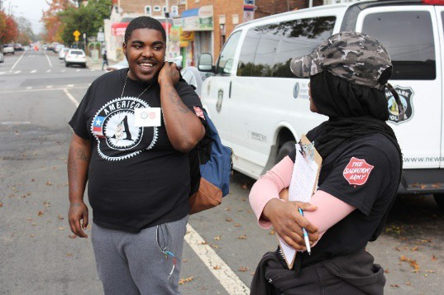
CONTACT INFORMATION
NJ Commission on National and Community Services
NJ Department of State
225 West State Street, 3rdFloor
PO Box 456
Trenton, NJ 08625-0456
AmeriCorps.NJ@sos.nj.gov

