Slide 1
AmeriCorps 101
The who, what, where, when, why and how for AmeriCorps Members
Presented by Lori Barrows,
AmeriCorps NJ Program Officers

Slide 2
AmeriCorps 101 Syllabus
What is AmeriCorps?
AmeriCorps in NJ – Stats
AmeriCorps Members’ Benefits
Education Award
Terms of Service / Term Limits
Documentation of Hours Served
Prohibited Activities
Member Timeline
AmeriCorps Pledge

Slide 3

What is AmeriCorps?
Notes:
Let’s start with this short video. It defines AmeriCorps really well!

Slide 4
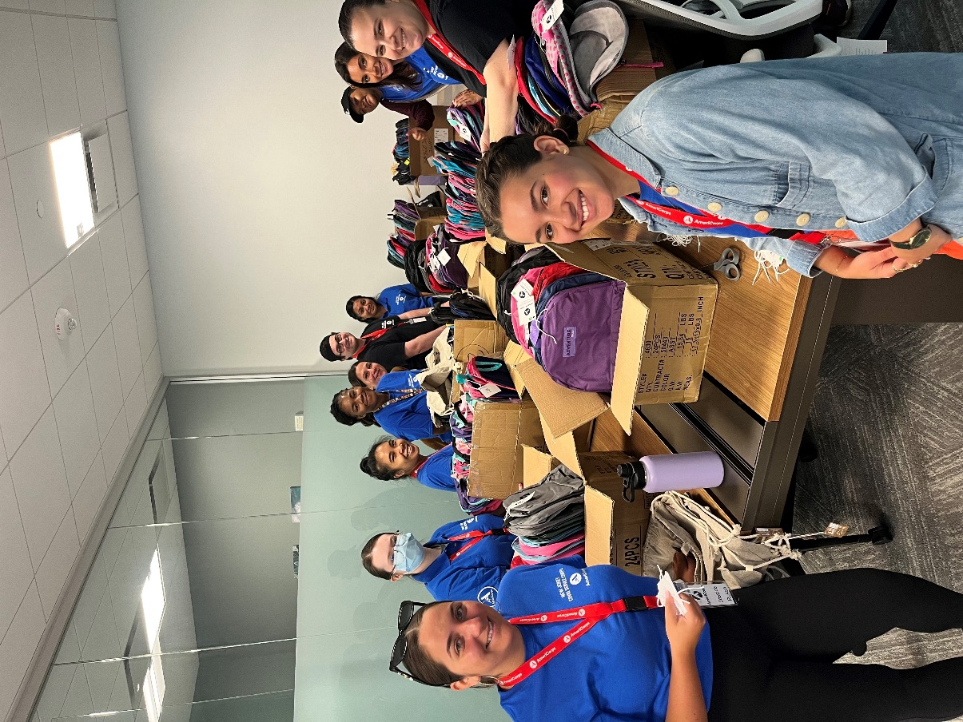
So, what is AH-MER-EE-CORE, again?
AmeriCorps “ Lingo”
It’s not a job, internship or a volunteer opportunity – it is service – You are called AmeriCorps members!
Members Do not earn wages or a salary – you receive a living allowance or stipend
AmeriCorps members are not employees – you are there to create a change in the community through direct service!
You are the boots-on-the-ground in the community and you get things done to improve lives!

Slide 5
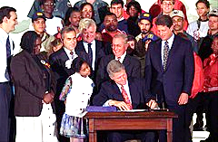
History of AmeriCorps
President Bill Clinton signs the National and Community Service Trust Act of 1993, creating AmeriCorps and the Corporation for National and Community Service to expand opportunities for Americans to serve their communities.

Slide 6
What do AmeriCorps Members Do?
Educate communities about their environment
Renovate and Rebuild Abandoned Homes
Provide Tutoring and Mentoring During Non-School Hours
Recruit Volunteers
Bridge the Digital Divide
Assist the Homeless
Provide Support to People with Disabilities

Slide 7
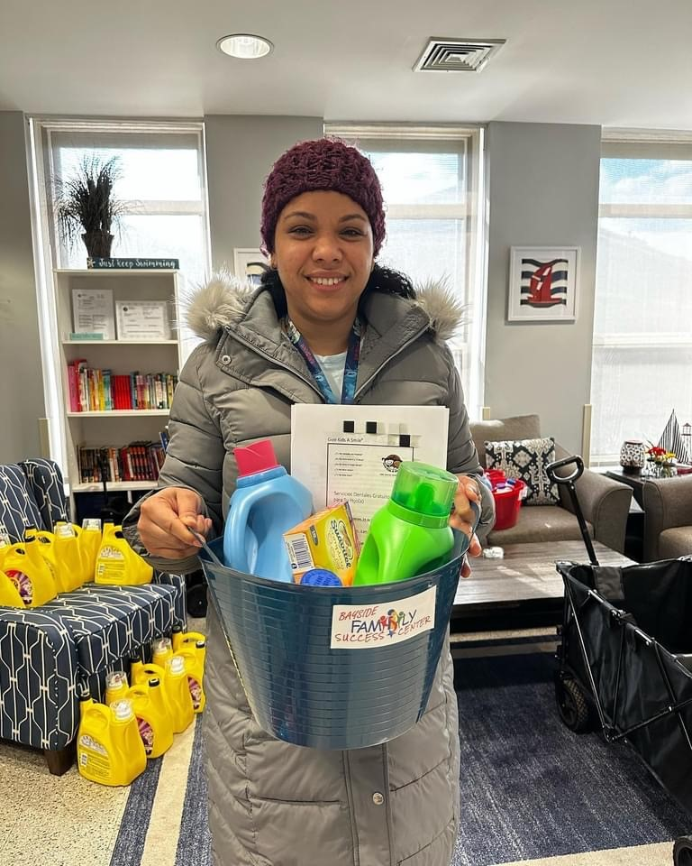
Members Get. Things. Done.
Your programs will be creating a huge impact in your communities and improving lives. You’ll develop a Theory of Change, propose research that will support that theory of change and provide a logical path to achieving community goals.
Your programs have identified a need in the area and developed a plan to create meaningful change. Your service will help educate students struggling with basic curriculum, teach members of the community to take care of the environment, assist our needy with respect to food insecurity and housing, among other important initiatives.

Slide 8
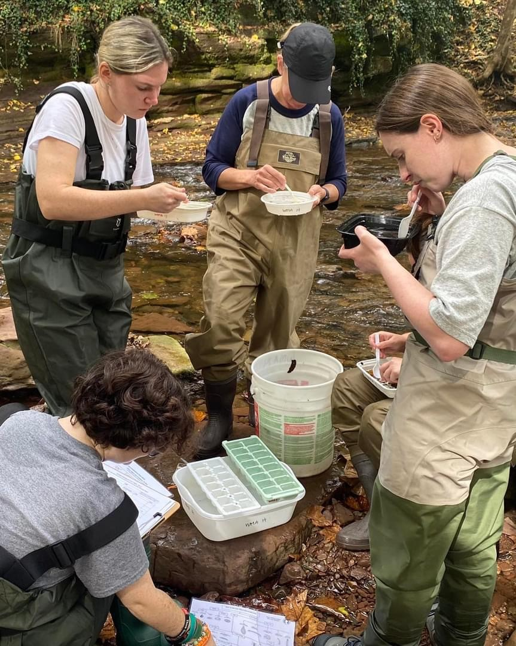
AmeriCorps Member
Fast Facts
90 % of members said they gained new skills while in AmeriCorps.
80% of members said they are more likely to participate in community service after AmeriCorps.
72% of members volunteered after completing their AmeriCorps service.
Since 1994, AmeriCorps alumni have earned more than $3.3 billion in education awards, including $1 billion to repay student debt.

Slide 9
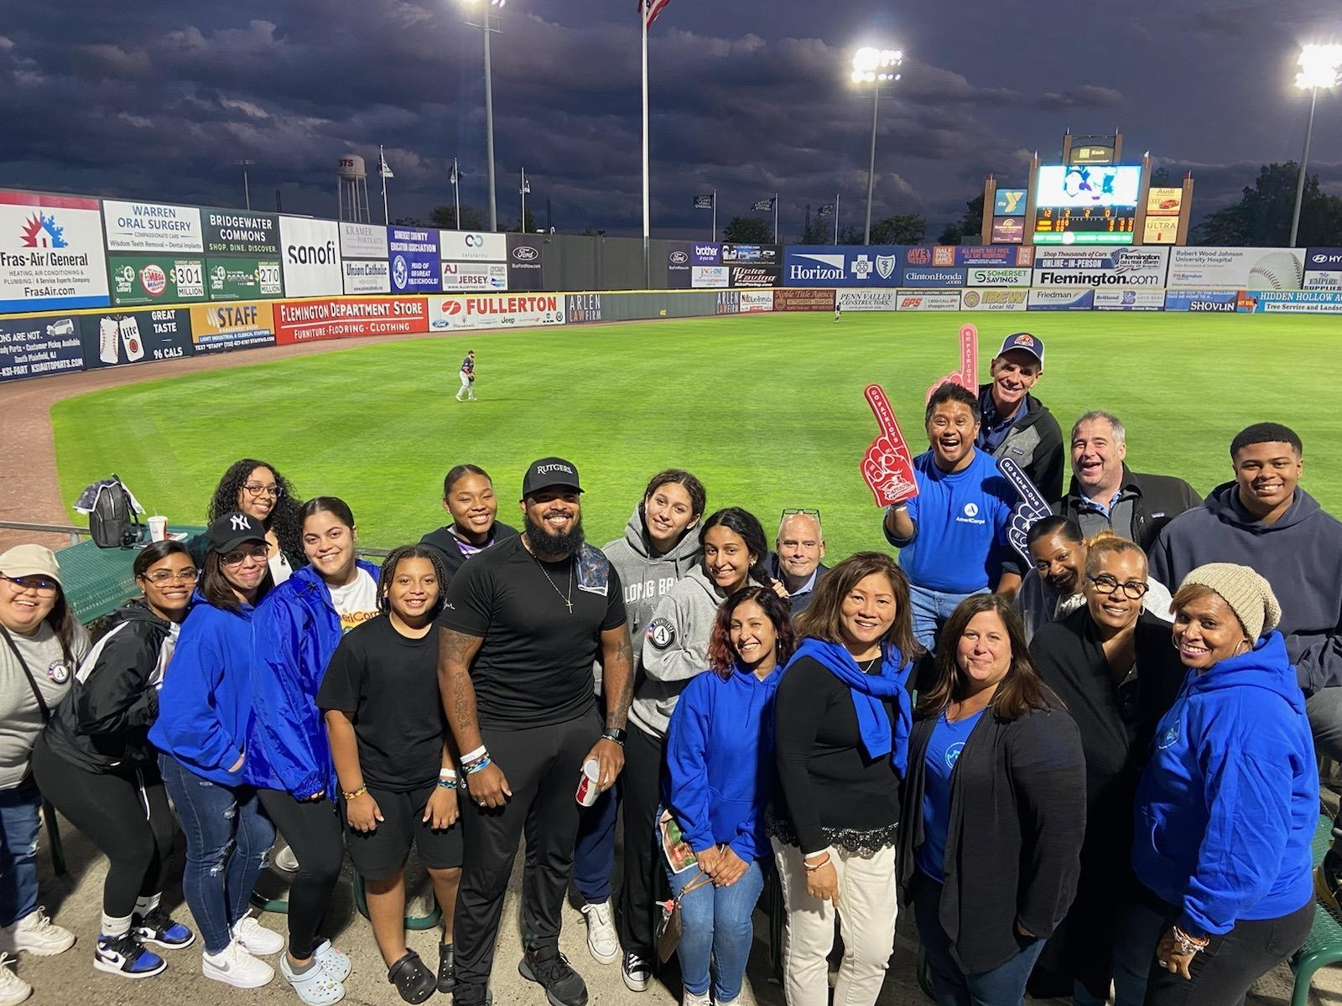
What did AmeriCorps New Jersey Members Accomplish in the 2022/2023 Program Year
Recruited 1,700+ volunteers
410 individuals received addiction intervention services
12,000+ children and youth served
13,000+ acres of public land improved

Slide 10
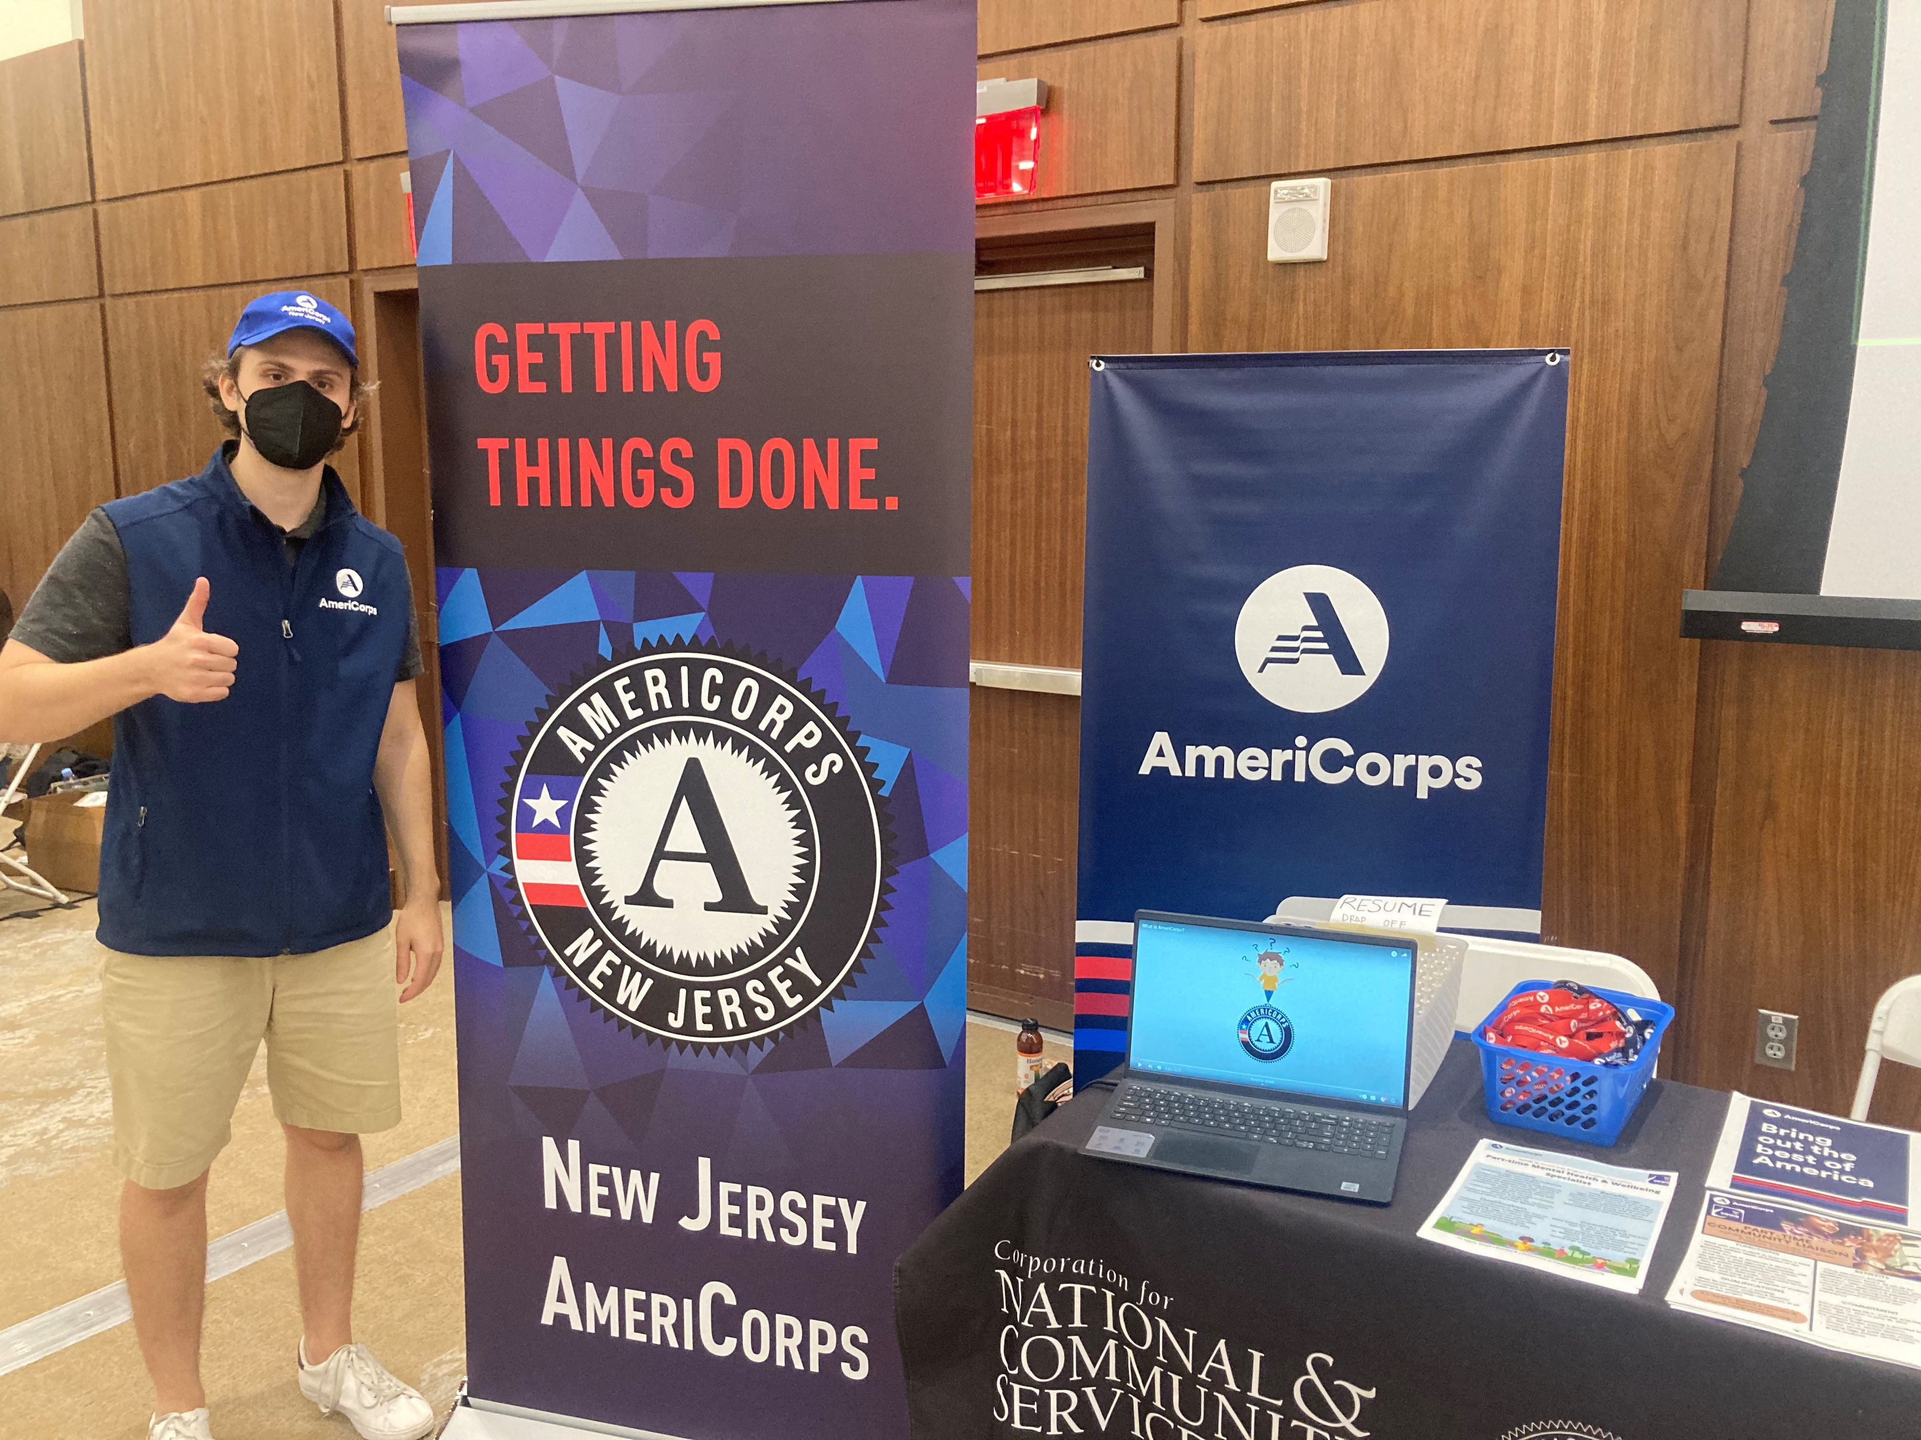
Focus Areas
Education
Economic Opportunity
Environmental Stewardship
Healthy Futures
Disaster Preparedness
Veterans and Families

Slide 11
What Do AmeriCorps Members Do For New Jersey Communities?
Many programs have members serving in schools and supporting students’ improvement with attendance and engagement.
Programs serve as a pathway to employment opportunities and help develop vital work skills and financial stability.
Members protect thousands of acres of public lands throughout the state to help conserve natural habitats, protect clean air and water and promote energy efficiency.
Programs also build capacity at food banks, address food insecurity, combat the opioid crisis, and assist in alleviating homelessness.

Slide 12

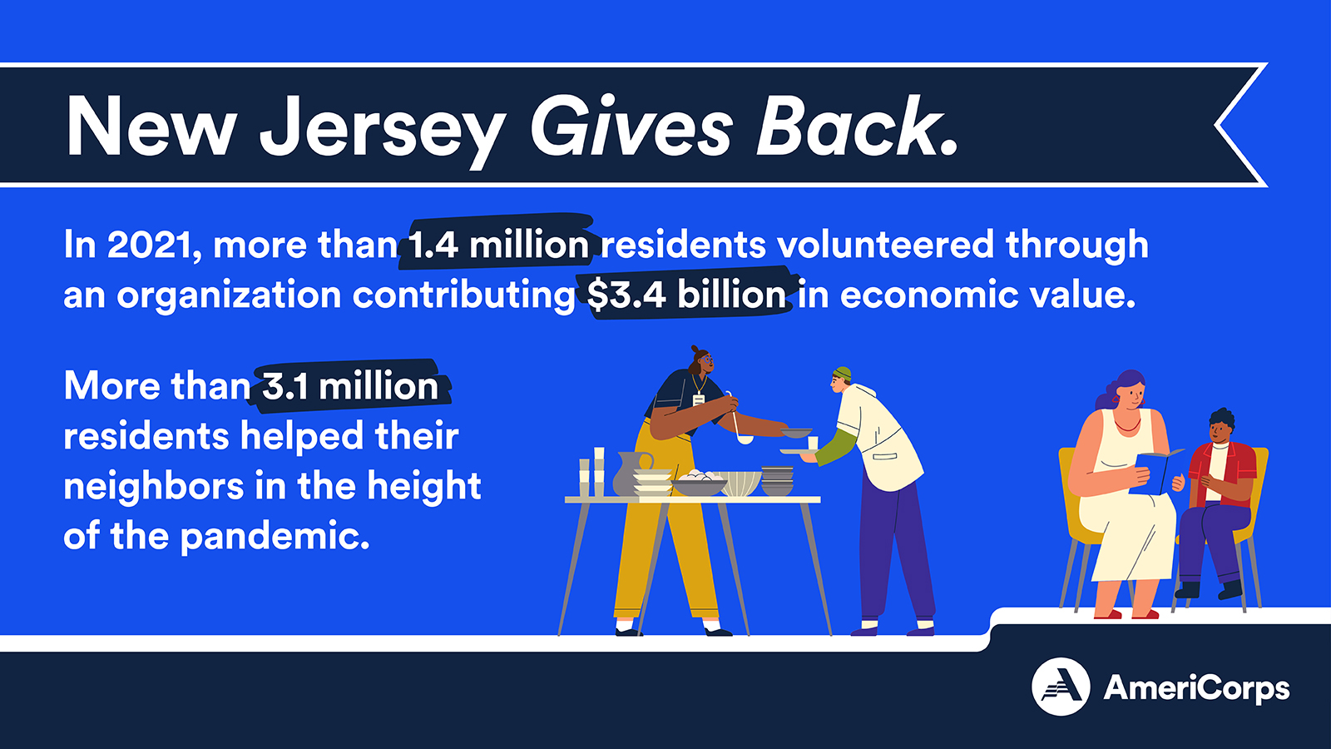
New Jersey Volunteers!

Slide 13
Member Eligibility Requirements
Must be 17 years of age or older.
Must have a High School Diploma or Equivalency; or must be working towards the GED.
Must be a US Citizen or Permanent Resident of the USA.
Proof: Birth Certificate and/or Specific LIMITED Acceptable Documents

Slide 14
Background Checks: Every Member must Agree to These:
The following background checks must be cleared by the NJ Commission before AmeriCorps members can be enrolled to begin service:
  State Background (TrueScreen)
  FBI Fingerprint-based (FieldPrint)
If you reside outside of New Jersey, additional out-of-state checks are required

Slide 15

Members’ Benefits
Child Care (For FT members)
Health Insurance (For FT members)
Student Loan Forbearance (During time of service)
Student Loan Interest Accrual Stops
Living Allowance
Education Award

Slide 16

Education Award
Notes:
Upon completion of their terms of service, members are eligible for an Educational Award.
The amount of the award corresponds to the slot type they have agreed to serve. Upon enrollment, your program director will have not only worked our their weekly living allowance or stipend, but also the total educational award amount they’ll receive.
Members have up to seven years to use the award and it can be used at more than one institution and can help pay more than one loan.
If a member is 55 years old or older, the educational award can be transferred once to a child, grandchild, foster child or step child and is held for up to 10 years!

Slide 17
Upon completion of your term of service, members are eligible for an Education Award.
The amount of the award corresponds to the hours you have agreed to serve. Upon enrollment, your program director will have not only worked our your weekly living allowance or stipend, but also the total education award amount they’ll receive.
Members have up to seven years to use the award and it can be used at more than one institution and can help pay more than one loan.
If a member is 55 years old or older, the educational award can be transferred once to a child, grandchild, foster child or step child and is held for up to 10 years!

Slide 18
Education Award Amounts
Type of Member Position | Min. # of Hours | Education Award
Full-time | 1,700 | $6,895.00
Three Quarter-time | 1,200 | $4,826.50
Half-time | 900 | $3,447.50
Reduced Half-time | 675 | $2,626.27
Quarter-time | 450 | $1,824.07
Minimum-time | 300 | $1,459.26
Abbreviated-time | 100 | $388.03

Slide 19

Terms of Service
A member can serve up to four terms of service… but cannot earn or receive more than the equivalent of 2 full-time awards.

Slide 20
Timesheets: All Members Must Keep Detailed Record of Service Time
Members must identify all their service activities in their timesheets.
We use OnCorps Reporting system for this. Your Program Director will train you in thee use of this system
And don’t forget to submit them! If timesheets are not submitted properly and regularly, it may negatively effect your in-service and post-service benefits such as your living allowance and education award!
Improper timesheet reporting may create a disallowance for your program. Any of the AmeriCorps funds, deemed to have been used improperly, can result in a disallowance.
The funds will have to be paid back and a fine may be implemented.

Slide 21

Prohibited Activities
Attempting to influence legislation;
Organizing or engaging in protests, petitions, boycotts, or strikes’;
Assisting, promoting, or deterring union organizing;
Impairing existing contracts for services or collective bargaining agreements;
Participating in, or endorsing, events or activities that are likely to include advocacy for/or against political parties, political platforms, political candidates, proposed legislation, or elected officials;
Census Activities
Election and Polling Activities

Slide 22

AmeriCorps: The Best of America
Notes:
We wanted to end with another quick vide by AmeriCorps.

Slide 23
AmeriCorps 101
Thank you all for Participating in Launch!
Welcome to the New Jersey AmeriCorps Team!
Notes:
Thank you for participating in AmeriCorps 101. It was my absolute pleasure to talk about AmeriCorps with you.

